Slide 1
Staying the course
ADMASTER-STAMP!MGR0330222101104
ADMASTER-STAMP!GA0110254145450
Retirement strategies for any market conditions
The Manufacturers Life Insurance Company
Notes:
[PRESENTER: All notes to the presenter are set in bold, italic, and within brackets throughout the presentation.]
Hi, everyone,
I’m [host name]. Thanks for finding the time to join me.
Let’s jump in: When the markets fluctuate, it’s natural for people to feel anxious about their savings. I’m here to help explain why you may want to stay the course in any market conditions.

Slide 2
How you can take control of your financial future
Contribute regularly
Focus on your long-term strategy
Keep your account up to date
Notes:
Today, we’ll explore reasons behind market fluctuations and discuss strategies to help keep you focused on your goals.
These strategies include:
Regularly contributing to your retirement account
Focusing on your long-term strategy
The importance of keeping your account up to date

Slide 3
Contribute regularly
Notes:
Your retirement plan is designed to make saving for retirement as easy and convenient as possible. Making regular contributions to your retirement plan is an investment strategy that can help you take advantage of market fluctuations.
How, you may ask?

Slide 4
Benefits of contributing regularly
ADMASTER-STAMP!MGR0913222411560
You may pay less in taxes¹
You can use dollar cost averaging²
Your money has the potential to grow
You are always in control
1 Contributions to an RRSP are tax-deductible and investment growth within the account is not taxed, 2 Dollar cost averaging does not guarantee a profit or eliminate the risk of a loss. Systematic investing involves continuous investment in securities regardless of price level fluctuation. Members should consider their resources to continue the strategy over the long term.
Notes:
Contributing regularly has many benefits.
Saving through your retirement plan is easy because the money comes out of your paycheck automatically and goes directly into the plan. Plus, you may be able to make pretax contributions, which can help lower your taxable income and reduce the taxes you pay today.
Dollar cost averaging is a fancy way of saying that you invest a certain amount on a schedule. For example, you could invest $500 every month, no matter what. In this way, you can take advantage of dollar cost averaging, which can help smooth out market fluctuations and help you build your retirement savings. That way, you’re not trying to time the market and figure out when to buy low and sell high.
Another benefit is that your money has the potential to generate investment earnings, which compound, or go back into your account. This can give you more money to generate more earnings, which are also added to your account. Although not guaranteed, over time, compounding can have a significant impact on your savings.
And remember, when it comes to your retirement account, you are always in control. Even if you change jobs, your contributions and earnings belong to you.
Let’s look at each of these benefits more closely.

Slide 5
Help lower your taxes by saving in your plan
ADMASTER-STAMP!MGR1108222572405
 | Tax savings today RRSP contributions
Income limits | N/A
Contributions | Pretax
2025 contribution limit¹ | $32,490
2024 contribution limit¹ | $31,560
Age limit | 71
Investment earnings | Tax deferred²
Withdrawals | Taxed on withdrawal²
1 The annual contribution limit is 18% of earned income, up to a set maximum amount. Unused contribution from previous years can be added to the current year’s limit. 2 Ordinary income taxes are due on withdrawal. RRSPs must be converted to a RRIF at age 71, which have minimum withdrawals.
Notes:
Saving through your plan can help lower your taxes.
Pretax contributions are deducted from your paycheck before taxes are taken out and may lower your annual income taxes. Your savings grow tax deferred, so your money and any earnings aren’t taxed until withdrawal, ideally at retirement, when your tax rate may be lower.
You can find your personal RRSP limit by calling the Canada Revenue Agency (CRA), signing in your online account, or checking your most recent notice of assessment. That’s the PDF or document you get after you file your taxes.
Keep in mind that your contributions can’t exceed your personal limit of contribution room. There’s a grace amount of $2,000, but if you add even more than that amount, you’re taxed 1% per month on the excess contribution.

Slide 6
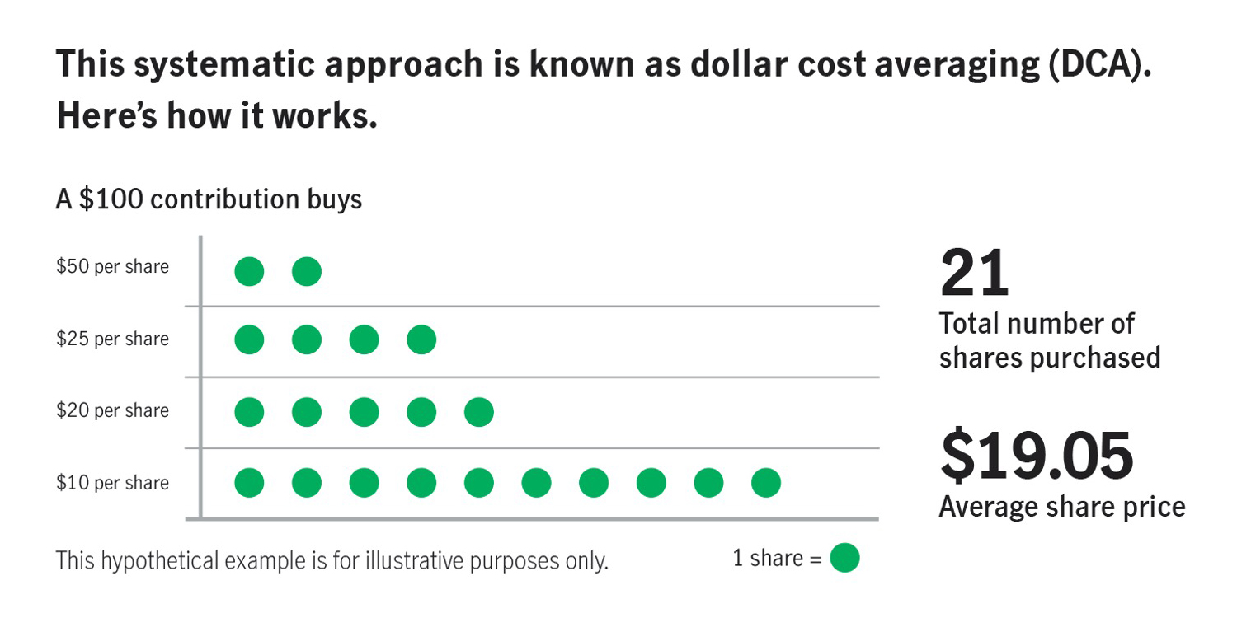
Continue to contribute
ADMASTER-STAMP!MGR0311222073682
The term share refers to investments in publicly traded mutual funds. Dollar cost averaging does not guarantee a profit or protect against a loss. Systematic investing involves continuous investment in securities regardless of price level fluctuation. Participants should consider their resources to continue the strategy over the long term. There is no guarantee that an investment strategy will achieve its objective. Past performance does not guarantee future results.
Notes:
Another benefit is the automated, consistent investing strategy.
You invest a set amount of money each pay period—regardless of whether your investments are moving up or down in value—which is known as dollar cost averaging. When you keep this strategy during market declines, you can reduce your average share cost and accumulate more shares of each investment.
As an example, let’s look at this graph. This hypothetical example shows that when the market value drops from, say, $50 to $10, you’re able to buy more shares at the lower price.
As the price increases, you get fewer shares for your $100. Over time, the high and low prices average out, which can help smooth market fluctuations, helping you make progress on your retirement goals.
This systematic approach to investing is known as dollar cost averaging.

Slide 7
Your money has the potential to grow—then grow more
ADMASTER-STAMP!MGR1108222572405
$267 per month, or $3,200 per year
Assumes 5% annual growth
For illustrative purposes only. Figures assume a beginning balance of $0, a $267 monthly contribution, 5% annual rate of return, and 10, 20, and 30 years of savings. Individual circumstances may vary. There is no guarantee that the results shown will be achieved or maintained over any time period. This example assumes no withdrawals; does not take into account fees associated with investing, which, if included, would reduce the account balance; and assumes reinvestment of earnings. Taxes are due on withdrawal.
Notes:
When you save through your retirement plan, your deposits can generate earnings, which go back into your account, giving you more money to generate more earnings, which are also added to your account. This is called compounding, and although it’s not guaranteed, it may have a significant impact on your retirement savings. The more time you give your savings to grow, the greater potential your savings have to accumulate additional earnings and the better prepared you’ll be for the future.
Look at what happens to an investment of $3,200 per year: In 10 years, it becomes approximately $41,000, in 20 it’s over $109,000, and in 30, it’s more than $220,000.
The earlier you start saving, the more powerful the effect of compounding may be. Although the power of compounding is most dramatic over a long period of time, it also helps in the short term, so it’s never too late to start saving for retirement.

Slide 8
Time is on your side
ADMASTER-STAMP!MGR0913222411560
$127,994
$252,277
$456,981
For illustrative purposes only. Figures assume a beginning balance of $0, a $267 monthly contribution, and 5% annual rate of return. Individual circumstances may vary. There is no guarantee that the results shown will be achieved or maintained over any time period. This example assumes no withdrawals; does not take into account fees associated with investing, which, if included, would reduce the account balance; and assumes reinvestment of earnings. Taxes are due on withdrawal.
Notes:
While it’s never too late to start saving, the earlier you start, the more time your savings has the potential to compound and accumulate additional earnings, and the better prepared you can be for the future.
[Walk through the numbers on the screen.]
Save $3,200 a year until age 67
Earn 5% rate of return
Savings at retirement:
Age 25 = $456,981
Age 35 = $252,277
Age 45 = $127,994

Slide 9
You are always in control
Build your savings with regular contributions
Adjust or rebalance your contributions
Prioritize your retirement
Notes:
You can control your financial future by building your savings. By consistently adding to your account, you ensure that you’re steadily increasing your savings, which may lead to greater financial wellness in retirement.
You can adjust your contributions at any time—move up or down based on what’s going on in your life. Just remember to adjust upward whenever possible. By contributing regularly, you can adjust your savings rate as your financial situation changes. This flexibility allows you to increase contributions when possible or reduce them if needed, helping you stay in control of your retirement planning.
Regular contributions encourage disciplined saving and help you prioritize retirement savings in your budget. This habit can lead to better financial management. Contributing regularly, regardless of whether investment prices are high or low, means that you buy more shares when prices are low and less when prices are high. Doing this over time can help smooth out market fluctuations and helping build your retirement savings.
And saving regularly also empowers you to actively manage your retirement savings, make informed decisions, and adapt to changing circumstances, giving you more control over your financial future.

Slide 10
Focus on your long-term strategy
Notes:
The next topic I’d like to discuss is ways you can stay focused on your long-term strategy.
Let’s face it, market fluctuations can be stressful, but understanding typical market behavior and managing your emotions can help you stay focused on your long-term retirement goals during uncertain times.

Slide 11
Key aspects of a savings strategy
Short-term versus long-term goals
Goal | Short-term goals | Long-term goals
Time horizon | Less than 5 years away | More than 5 years away
Example | Car, big vacation | Down payment for a house, retirement
Investment strategy | Conservative investments to help maintain value | More growth-oriented investments
Notes:
Let’s examine what defines a short-term and a long-term savings strategy so we can distinguish between them.
Savings and investment strategies may vary depending on how far away your goals are.
For example, if you need your money soon, typically in less than five years, then you may want to choose lower-risk investments that are more likely to maintain their value. If you won’t need your money for a while, then you should think about when you’ll need access to your savings. Generally, the longer your investment horizon, the more short-term volatility you can handle.
​If you’re unsure about your risk tolerance, take a risk quiz to determine your risk profile, then align your strategy with your timeline and comfort level and review it regularly.
Developing a long-term strategy that looks ahead five or more years can help ensure you save enough for the retirement you envision. For example, your long-term savings goal might be a down payment on your home or saving for retirement. However, with a longer time horizon, long-term investments might include taking some risks in the hopes of achieving greater returns.
For additional guidance, consider speaking to a licensed financial professional who can help you with your specific situation.
Let’s look at some ways to help you stay focused on your long-term retirement savings goals.

Slide 12
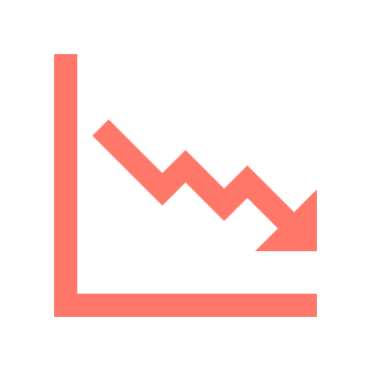
What moves the stock market up and down?
ADMASTER-STAMP!MGR0330222101104
Company profits
Interest rates
Consumer confidence
Economic outlook
Political climate
Unforeseen events such as the pandemic
Past performance does not guarantee future results.
Notes:
What causes volatile market conditions, anyway?
The stock market can be quite complex, and there are many factors that move the stock markets every day. ​
In any stock market move, whether up or down, there’s a significant difference between supply and demand. Simply put, supply is the number of shares people want to sell, and demand is the number of shares people are looking to buy. After all, the stock market itself is just a collection of individual companies. If more people want to buy a stock (demand) than sell it (supply), the price moves up. On the other hand, if more people want to sell a stock than buy it, there would be greater supply than demand, and the price would fall.
Other factors that determine whether stock prices rise or fall include the media, company profits, consumer confidence, natural disasters, political and social unrest, and unforeseen events such as the pandemic, inflation, and risk. The collection of these factors, plus all relevant information that’s been published, creates a certain type of sentiment. The sentiment may be bullish, meaning positive, or bearish, meaning negative.
If we look back at what happened during the pandemic, a lot of the market activity was driven by the potential impact of COVID-19 on company profits, consumer confidence, and spending.
Understanding market fluctuations can help you take control of your financial future.

Slide 13
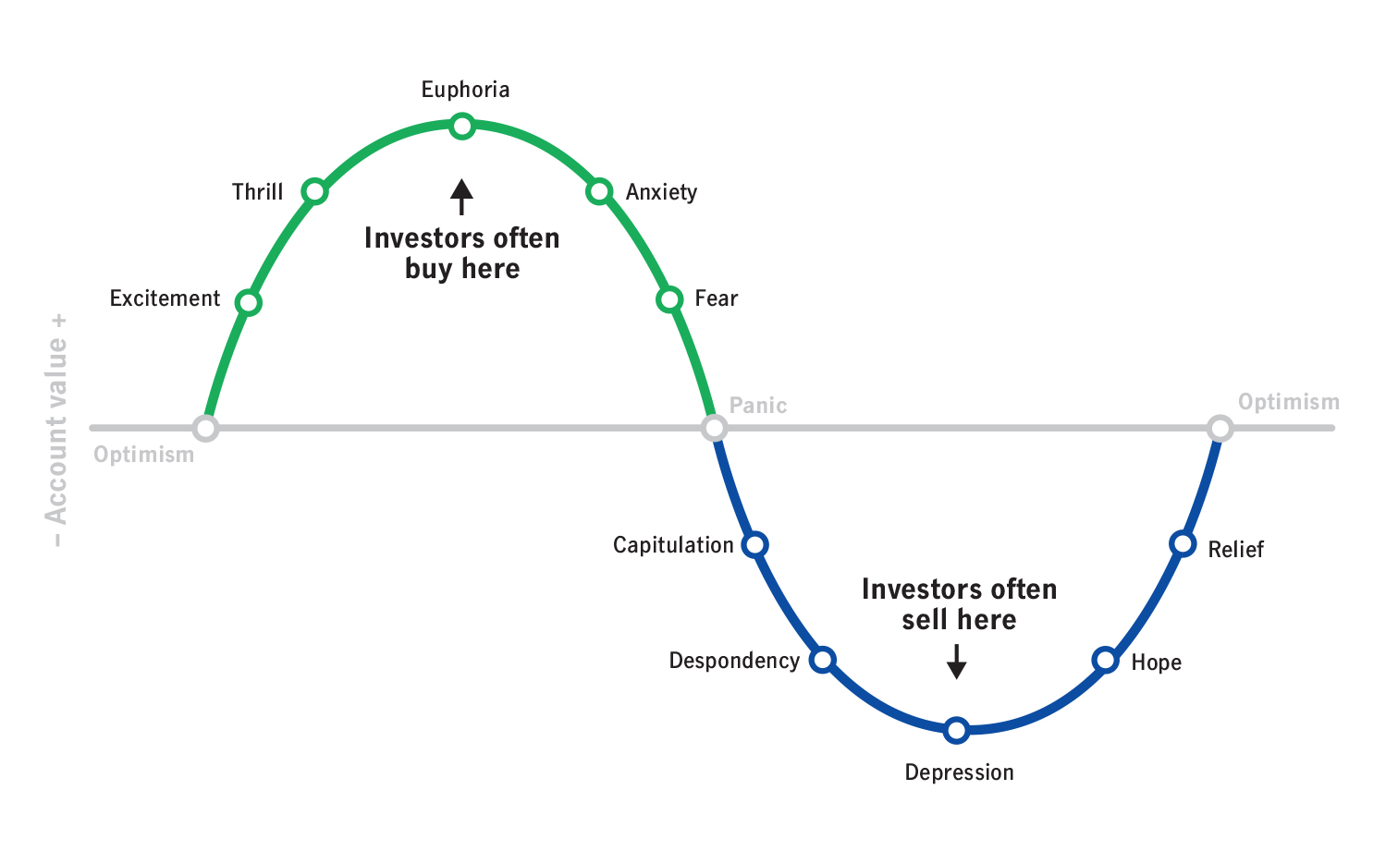
Keep emotions out of investing
ADMASTER-STAMP!MGR0311222073682
For illustrative purposes only. There is no guarantee that any investment strategy will achieve its objectives.
Notes:
Taking emotion out of the equation when markets fluctuate can also help you remain focused on your long-term retirement strategy.
It’s natural for emotions to play a role in many of the decisions we make—and investing is no exception. This graph shows the emotional highs and lows the average investor can experience over the course of a typical market cycle.
Think about how you feel when financial markets are rising. Investors who make decisions based mainly on their emotions are often tempted to buy in these situations, when prices are higher.
Now consider how your emotions change when you’re surrounded by negative stories and headlines about how poorly the financial markets are doing. At this point, it’s not uncommon for investors to begin to question whether they should be in the market and often sell when prices are falling.
These emotion-based decisions can cause you to buy and sell at inopportune times, leading to setbacks in your retirement savings.
The more you understand market cycles, the easier it is to stay calm.

Slide 14
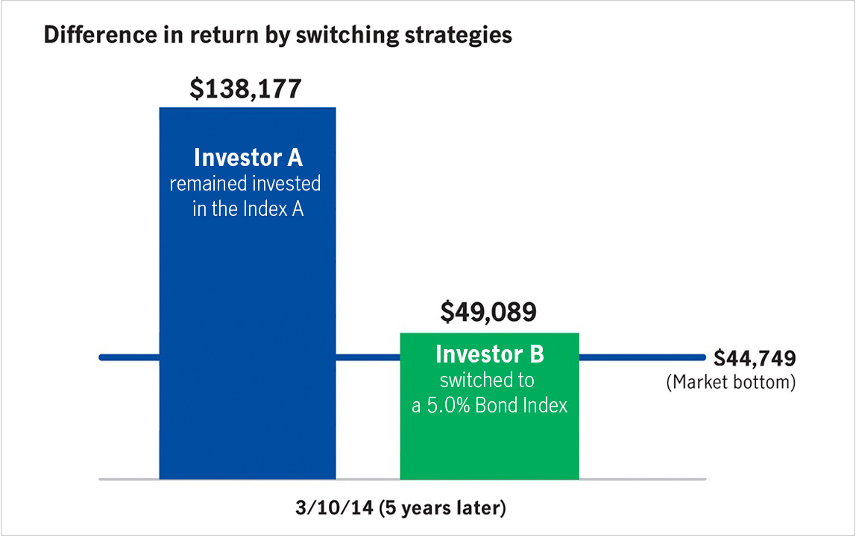
Choose to stay invested
ADMASTER-STAMP!MGR0311222073682
Source: Morningstar, Inc., S&P 500 Index, March 2023. For illustrative purposes only. Indexes are unmanaged and cannot be invested in directly. You should always keep in mind, however, that you cannot count on the market to behave the same way in the future as it has in the past. These comparisons, while a helpful way to evaluate your investment options, should not be considered predictors of future performance..
Notes:
Assume two investors had $100,000 invested at the market peak on October 9, 2007. After the market fell on March 9, 2009, their investments would’ve been worth $44,749.
Investor A stayed calm and remained fully invested. Five years after the market fell, the investment recovered and was worth $138,176.60.
Investor B got scared and moved money into fixed income, thinking that would be safer. Five years after the market fell, the investment recovered only 9.7% of its loss.

Slide 15
Build a confident retirement savings plan
Create a long-term strategy to build and maintain your savings
Get to know what investing looks like in all market conditions
Be prepared. Stay calm.
Notes:
So, to sum up:
Investing in your retirement plan uses a long-term savings strategy, so you need to understand what investing looks like in all market conditions—whether it’s inflationary, recessionary, or volatile.
Focus on making short-term decisions that don’t put your long-term retirement strategy at risk.
And remember, don’t add emotion into your investing. Instead, stay calm, and remember that your savings are invested for the long term.

Slide 16
Keep your account up to date
Notes:
Change is inevitable, so you need to be prepared.
Let’s look at some ways that can help you stay on top of your account and stay focused on your goals.

Slide 17
Importance of reviewing your account
Review your account annually
Update your contact information
Name your beneficiaries and keep their contact information current
Notes:
A good habit for you to start is reviewing your retirement account each year, much like how you routinely change the batteries in your smoke detector.
You can add a yearly reminder to your calendar to review your contact information, including your email address and mobile number. This helps make sure you stay informed and don’t miss out on important information such as transaction confirmations and plan updates.
Also, be sure to look at your beneficiary information and make sure it’s current. If something happens to you and you didn’t name your beneficiary, the legal system may decide where your assets go for you. Keep in mind that beneficiaries for other benefits, such as your pension, life insurance, and medical plan, don’t carry over to your retirement plan.

Slide 18
Think about how much you’re saving
Consider increasing your contributions
How much are you saving?
Are you taking advantage of tax benefits?
Notes:
Your retirement account is easy to forget about—you make contributions with every paycheck, and it can seem like that’s all you need to do. But take some time to think about your contribution rate and whether you can save more. How much are you saving from each paycheck? Did you get a bonus this year? How can contributing more help you with minimizing your current taxes?
Things in your life can change. Are you saving enough right now to reach your goals? If you can, consider increasing your contributions for the next year—maybe right after you get a raise, so you won’t miss the extra money being taken from your paycheck. Saving even a little more can really add up over time.
As I mentioned earlier, understanding the tax impact of your RRSPs can help reduce your taxes and optimize your savings. Evaluate your current financial situation to see if increasing your contributions this year might place you in a lower tax bracket.

Slide 19
Evaluate your investments and goals
Check in on investment choices and goals—adjust as needed
Regularly review and adjust your investments as needed
Align investments with your risk tolerance and retirement timeline
Get your personalized plan for retirement and understand your savings needs with our retirement planner
Notes:
When reviewing your account, evaluate your current investments. Are your investments diversified? Do they make sense for your strategy?
Your retirement program gives you a range of investments to choose from, including mutual funds, stocks, bonds, and target-date funds. Looking at how your investments did over the past year can help you decide if you need to make any changes so you can stay on track to meet your retirement goals. Major life events such as marriage, having children, or changing jobs can affect your retirement plan.
The investments you choose depend on how much risk you’re comfortable taking and how long you have until retirement. Generally, the more time you have until you retire, the more risk—and potential reward—you can take on. Market conditions can change over time, so your investment performance may not match your original plan. You can review your investments to adjust the amount you invested in each fund or change your investments based on how much risk you want to take, when you want to retire, and the performance of your investment options.
All these reasons are why it’s important to check in on your investment choices. By doing this, you can ensure that your retirement plan is personalized and reflects your unique financial journey and priorities. You can use the retirement planner on your retirement plan website to personalize your plan and understand how much you’ll need to save today to cover your expenses and the lifestyle you want in retirement.

Slide 20
Explore your resources
Learn about market volatility
Download our mobile app (EN)
Download our mobile app (FR)
Notes:
Did you know that you can explore market volatility and learn how to manage your investments?
Our market volatility page offers a range of resources, including articles, videos, and webinars, to help you understand the stock market, investment fundamentals, and strategies for maintaining your long-term retirement goals.
Additionally, you can visit your retirement plan website or our mobile app to access education tools and calculators designed to keep you on track.

Slide 21
How staying the course helps you plan for your retirement
Notes:
As we reach the end of our discussion today, here are a couple of things to keep in mind when you’re investing in the market.

Slide 22
ADMASTER-STAMP!MGR0330222101104
w
Stay calm in all market conditions
Stay committed to your plan
Turn market volatility into an advantage
Continue your regular contributions
Take a long-term perspective
Talk to a licensed financial professional
Keep your account updated
There is no guarantee that any investment strategy will achieve its objectives.
Notes:
First, review your goals and stay disciplined and committed to your investment plan. If your goals and time frame haven’t changed, your investment strategy shouldn’t either.
Turn market volatility into your advantage by continuing your regular contributions.
Take a long-term perspective. Markets will rise and fall but, over time, markets have always moved higher. In the past, markets have recovered within a year or two of a correction.
If you think you need additional guidance, consider speaking to a licensed financial professional who can help you with your specific situation. Access to a Manulife Wealth advisor is included in many plans.
Finally, check in on your account to make sure your information is current and review your retirement account as you reach major milestones or as your personal financial situation changes.

Slide 23
Thank you!
Information in this presentation is for educational purposes and not intended to constitute expert advice on any particular matter.
Notes:
Thank you for attending this session.
I hope you’ll leave feeling more confident about saving for your future—especially during market fluctuations.

Slide 24
ADMASTER-STAMP!MGR0330222101104
Important information
It is your responsibility to select and monitor your investment options to meet your retirement objectives. You should review your investment strategy at least annually. You may also want to consult your own independent investment or tax advisor or legal counsel.
The content of this document is for general information only and is believed to be accurate and reliable as of the posting date, but may be subject to change. It is not intended to provide investment, tax, plan design, or legal advice (unless otherwise indicated). Please consult your own independent advisor as to any investment, tax, or legal statements made.
Manulife, Manulife Retirement, Stylized M Design, and Manulife Retirement & Stylized M Design are trademarks of The Manufacturers Life Insurance Company and John Hancock and the Stylized John Hancock Design are trademarks of John Hancock Life Insurance Company (U.S.A.). Each are used by it and by its affiliates under license, including John Hancock Life Insurance Company of New York.
John Hancock Retirement Plan Services LLC provides administrative and/or recordkeeping services to sponsors or administrators of retirement plans through an open-architecture platform. John Hancock Trust Company LLC, a New Hampshire non-depository trust company, provides trust and custodial services to such plans, offers an Individual Retirement Accounts product, and maintains specific Collective Investment Trusts. Group annuity contracts and recordkeeping agreements are issued by John Hancock Life Insurance Company (U.S.A.), Boston, MA (not licensed in NY), and John Hancock Life Insurance Company of New York, Valhalla, NY. Product features and availability may differ by state. All entities do business under certain instances using the John Hancock brand name. Each entity makes available a platform of investment alternatives to sponsors or administrators of retirement plans without regard to the individualized needs of any plan. Unless otherwise specifically stated in writing, each entity does not, and is not undertaking to, provide impartial investment advice or give advice in a fiduciary capacity. Securities are offered through John Hancock Distributors LLC, member FINRA, SIPC.
Group Retirement products and services are offered by The Manufacturers Life Insurance Company (Manulife). © 2025 The Manufacturers Life Insurance Company. All rights reserved. Manulife, PO Box 396, Waterloo, ON N2J 4A9. Accessible formats and communication supports are available upon request. Visit Manulife.ca/accessibility for more information.
NOT FDIC INSURED. MAY LOSE VALUE. NOT BANK GUARANTEED.
© 2025 Manulife John Hancock Retirement. All rights reserved.
CRET- 286632

Slide 25
ADMASTER-STAMP!MGR0330222101104

