Slide 1

Transparency that matters:
Creating a sustainable practice
Using Total Cost Reporting (TCR) to deepen client trust
Name
Title
neral public
Notes:
Good morning/afternoon/evening. My name is ____________________ and I am a _____________________ with Manulife Investments.
Today, we are going to talk about Total Cost Reporting, or TCR, and more specifically, how advisors can use this change to deepen client trust. Many of you have already lived through several waves of regulatory reform, so the purpose today is not simply to review another compliance requirement. The purpose is to help you prepare for client conversations that may feel different once costs are presented in a clearer, more personalized way.
TCR takes effect for reporting periods beginning January 1, 2026, with enhanced annual cost reporting expected to reach clients in early 2027. The fees themselves are not new, but the visibility will be different. That creates a practical question: will clients hear the explanation from you first, or will they form their own interpretation before you have a chance to provide context?
Before we get into the technical details, I want to start with a broader mindset shift.

Slide 2


Shift your mindset
Those who understand the data early, shape the narrative. Those who don’t, get described by it.
Notes:
Let me begin with two familiar stories: Moneyball and The Social Network. Who here has seen the movies Moneyball and/or The Social Network?
Now I won’t go into too much detail or share the entire movie with you, but there is something that is very important. Let’s start with Moneyball.
Moneyball
Traditionally, baseball scouts relied on their own experience and instinct when recruiting players. However, Billy Beane, the general manager of the Oakland A’s, decided to add a new quantifier - data. At first, that approach was resisted because it challenged how people defined value. But eventually, results forced the competition to take notice. As a result, the business of drafting, recruiting, and trading players was forced to change. Once the data became visible, it could no longer be ignored.
TCR creates a similar moment for advice. It does not eliminate the value of the advisor. It changes how some clients may interpret cost and value because more information is made visible in dollar terms.
Moneyball wasn’t about replacing scouts. It was about making the invisible, visible. Total Cost Reporting is the same; it doesn’t eliminate advice, it forces the industry to explain its value in a new language. ”The fees were always there. What’s changing is who has to explain them, and how.”
The Social Network
When Facebook launched, it wasn’t because people didn’t already socialize. We all had relationships, phone numbers, email, and communities. What Facebook changed wasn’t connection, it changed how connection was measured, displayed, and compared. Suddenly, something that used to be abstract (who knew who, who mattered, who had influence) became visible, quantified, and impossible to ignore. And the people who understood that early helped shape how the world would interpret it. The people who dismissed it spent years reacting to it. Those who dismissed it early lost influence over its impact.
The Social Network offers a second lesson. Facebook did not invent relationships, but it changed how relationships were displayed, measured, and compared. Once something abstract became visible, people began interpreting it differently.
-----
That is the connection to TCR. Costs that already existed will now be easier for clients to see, understand, and compare. Advisors who understand the information early can shape the narrative. Advisors who wait may find themselves reacting to a narrative created by someone else: a search engine, a competitor, a headline, or a client’s own assumptions.
The key message is this: TCR is not just about cost disclosure. It is also about perception, communication, and trust.
Many advisors pride themselves on experience, judgment, and relationships—just like the baseball scouts. In our industry, data threatens to reframe value, not remove it.
Every industry eventually reaches a moment where nothing fundamental changes overnight, yet everything feels different because perception shifts (sure, some rules change and the data shifts) and the people with the most experience are often the most uncomfortable. This is often triggered not by new products or higher costs, but by increased visibility and simplicity. When information that was once complex, hidden, or abstract becomes clear and easy to interpret, people reassess value through a new lens.
In financial services, Total Cost Reporting represents that inflection point. Costs that have always existed are now presented in a way that clients can immediately understand, compare, and react to. This moment matters because perception drives behaviour. Even satisfied clients may pause, question, or seek reassurance when they see familiar costs expressed differently. So…
CLICK
If you don’t help define the message, someone else will. Those who understand the data early shape the narrative. Those who don’t, get described by it.

Slide 3
POLL
How would you rate your current level of knowledge about Total Cost Reporting (TCR)?
I have a strong understanding and regularly discuss TCR details with clients.
I have a good understanding, but could benefit from a refresher.
I have a basic awareness, but limited practical knowledge.
I’ve heard of TCR, but don’t fully understand it.
I’m not familiar with TCR at all.
Notes:
NOTE TO SPEAKER: If we are in a virtual setting, ask participants to please respond to the poll. If we are in person, simply ask them to reflect on where they would place themselves.
Let’s start with a quick check-in.
Question: How would you rate your current level of knowledge about Total Cost Reporting?
I have a strong understanding and regularly discuss TCR details with clients.
I have a good understanding, but could benefit from a refresher.
I have a basic awareness, but limited practical knowledge.
I’ve heard of TCR, but don’t fully understand it.
I’m not familiar with TCR at all.
REMINDER: As always, please confirm specific TCR guidance, approved language, and client communication requirements with your dealer’s compliance and legal teams.

Slide 4
Agenda
Clearing the clutter
Reframe the conversation
Lead with your playbook
Notes:
Here is how we will structure the conversation today.
First, we will clear the clutter. We will review what TCR is, what it covers, what it does not cover, and some of the key terms advisors should be comfortable explaining.
Second, we will reframe the conversation. The advisor-client discussion should not be reduced to fees alone. It should connect cost to the value clients receive: Planning, guidance, behavioural coaching, risk management, tax-aware decisions, and long-term confidence.
Third, we will lead with a playbook. This is the practical part: What to do before, during, and after client meetings so the conversation feels proactive, structured, and confidence-building.
NOTE TO SPEAKER: Don’t assume that they’ve never had the conversation. It is possible that many have already discussed fees – CRM2 conversations.

Slide 5
Clearing the clutter
5
Notes:
Let’s begin with the first section: Clearing the clutter.
The purpose of this section is to make sure we have a common understanding of TCR before we move into the client communication strategy. When advisors are clear, clients are more likely to feel clear. When advisors sound uncertain or overly technical, clients may become uncertain as well.
So, we will start with the regulatory context, then move into what is included and excluded, and the key metrics that will appear in the reporting conversation.

Slide 6
Reg reform timeline
CRM
introduced greater standardization in the client-advisor relationship and reporting.
Client Focused Reforms strengthened conduct, conflict of interest management, KYC/KYP, and suitability standards.
2004
2009
2016
2021
2026
Fair Dealing Consultation Paper laid the conceptual groundwork for enhanced transparency and investor protection.
CRM2
added annual reports on charges, compensation, and performance.
TCR
adds product-level embedded costs into client reporting.
Source: Based on CSA and OSC regulatory publications, including NI 31-103, CRM2, Client Focused Reforms, and CSA/CCIR Total Cost Reporting enhancements.
Notes:
I would like to point out that TCR is best understood as the next step in a longer journey of regulatory evolution toward transparency and investor protection.
For those of you who were in the industry in 2004, you may remember the OSC's paper on fair dealings, which laid the foundation for greater transparency…
In 2004, the Fair Dealing Consultation Paper helped lay the conceptual groundwork for enhanced transparency and stronger investor protection.
In 2009, Client Relationship Model reforms introduced greater standardization in client-advisor relationships and reporting. This included a more formal framework around relationship disclosure and account reporting. Some of you may recall that there was much reference made to National Instrument 31-103 (NI 31-103).
In 2016, CRM2 added annual reports on charges, compensation, and performance. Many will remember that in 2016, client relationship model 2 (CRM 2) was introduced, a major milestone in fee transparency. It introduced first performance reporting and then dealer compensation disclosure, showing clients how their portfolios performed in one statement and what they were paying to their advisors and dealers for advice in a second statement.
In 2021 (December 31), Client Focused Reforms strengthened conduct, conflict of interest management, KYC/KYP, (know your client and know your product), and suitability standards. The client-focused reforms implemented focused on managing conflict of interest. So, it wasn't enough just to disclose conflict of interest to clients, although that was still required in an enhanced format, but conflict of interest had to be dealt with in the best interest of clients.
And in 2026, TCR (CRM 3), finally, what we're here to discuss, the Total Cost Reporting, which is now in effect actual report will be sent to clients in early 2027). It adds product level cost, so showing ongoing costs of certain investment funds that client owns in personalized dollars on their statement.
How is it different from CRM2? CRM3 builds on CRM2. CRM3 expands transparency by including embedded fund costs, evolving CRM2 without replacing it.
So, we can say that regulatory evolution has been consistent, Total Cost Reporting did not emerge suddenly. It is the next step in a long-standing regulatory journey toward greater transparency, following earlier reforms such as CRM and CRM2. From the outset, the objective has been to help investors better understand what they pay and the value they obtain from working with you.
I invite you to view this as an opportunity to frame this as a continuum of trust and transparency, not as a standalone compliance event.

Slide 7
Focus of TCR
Investor awareness | Informed decision-making | Industry transparency | Consistency of reporting
7
Notes:
Focus of TCR – the “why” behind TCR is straightforward: Regulators want investors to have:
Better awareness,
Better information for decision-making,
Greater transparency, and
More consistent reporting
The key difference from CRM2 is that it focuses mainly on dealer and advisor compensation and direct charges. TCR expands the view by including embedded investment fund costs, such as fund expenses and trading expenses, alongside the charges clients may already see.
Importantly, clients will see certain costs in personalized dollar terms, not only as percentages. That matters because dollar amounts are easier for clients to understand and react to.
The message for clients should be simple: There are no new fees being introduced because of TCR. What is changing is the level of disclosure and the way information is presented. Your role is to help clients interpret that information in the context of their plan, outcomes, service, and ongoing advice relationship.
--
ADDITIONAL SPEAKER NOTES IF DESIRED:
As I previously mentioned and will continue to stress, TCR is not just a regulatory change – it is a communication and trust-building opportunity for advisors. The new reporting regime makes the full cost of investing more visible by combining dealer/advisor charges with embedded product costs, and advisors who can clearly explain those costs in relation to outcomes, planning, and ongoing value will be best positioned to strengthen client relationships
It is important to note that there are no new fees being introduced, only enhanced disclosure. What is changing is that clients will now see more complete and personalized dollar-based reporting, which means advisors need a proactive strategy for education, expectation-setting, and value articulation throughout 2026 ahead of the first TCR-enhanced reports in early 2027.

Slide 8
What is subjected to TCR requirements?
Mutual funds
ETFs (Canadian- and foreign-listed)
Segregated funds
Scholarship plans
Split share funds
Alternative mutual funds
Some closed-end funds offered by prospectus or purchased on exchange
8
Notes:
Now, for some advisors, there may be lingering questions and uncertainty as to what is subject to TCR, and what is not. What will be included in the January 2027 report (for 2026). I will remind you, verify with your dealer’s compliance and legal department for TCR guidelines.
This slide highlights products that are generally expected to be subject to TCR requirements.
Examples include mutual funds, ETFs, segregated funds, scholarship plans, split share funds, alternative mutual funds, and some closed-end funds offered by prospectus or purchased on an exchange.
For the annual report covering 2026, clients may see dealer compensation that continues to be reported under existing requirements, as well as embedded investment fund costs that are newly disclosed under TCR.
For investment funds, the annual report may show the Fund Expense Ratio and the dollar value of fund expenses for the period the client held the fund. Direct fund charges, where applicable, may also appear.
Please remember that the exact treatment of specific products and approved explanations should be confirmed with your dealer’s compliance and legal teams.
--
(Additional info for the speaker)
Under the CSA Total Cost Reporting enhancements and CIRO’s aligned rules:
Dealer compensation actually paid in 2026
Ongoing trailing commissions
Fee‑based account charges
Other dealer-paid compensation is already required under CRM2
These continue to be reported, unchanged in concept, but remain part of the annual report.
Embedded investment fund costs incurred in 2026 (new under TCR)
For each fund held during the year, clients will see:
Fund Expense Ratio (FER) = MER + TER
Dollar value of fund expenses, calculated for the period the client held the fund during 2026
These amounts represent costs incurred between Jan. 1 and Dec. 31, 2026, not estimates for future periods.
Direct fund charges incurred in 2026 (if applicable)
Redemption fees
Short‑term trading fees
Other fund‑level charges paid directly by the investor
These must be included where applicable.

Slide 9
What is not subjected to TCR requirements?
Pooled/prospectus-exempt funds
Labour-sponsored investment funds
Individual stocks and bonds
GICs
Structured products
Transaction-related fees tied to excluded products may still appear under existing CRM2 reporting
9
Notes:
Even though the report covers all of 2026, some costs may be excluded or limited…
Examples of products generally outside the scope of TCR requirements, including pooled or prospectus-exempt funds (OM funds – Offering Memorandum), labour-sponsored investment funds, individual stocks and bonds, GICs, structured products, and some other excluded products such as some foreign-listed products subject to data-availability exemptions.
A useful distinction for clients is that TCR focuses largely on investment fund costs that may not have been visible in the same way before. It does not mean every product or every cost will appear in the same format.
There are also practical considerations. Some fund expense information may be prorated based on the client’s holding period. Some amounts may be calculated using reasonable approximations under the applicable methodology. Certain transaction-related charges may continue to appear under existing CRM2 reporting or other statements rather than being duplicated here.
--
ADDITIONAL SPEAKER NOTE IF DESIRED:
Transaction charges are already shown elsewhere
Trading commissions and transaction charges continue to appear on trade confirmations and account statements; they are not duplicated as part of fund expense reporting.
Costs outside the client’s holding period
Fund expenses are prorated. If a client held a fund for only part of 2026, only the costs incurred during that time appear, not the full‑year fund expenses.
Estimated or approximated amounts
Fund expense dollars may be calculated using reasonable approximations, so figures reflect regulatory methodology rather than exact invoice-style amounts.
EXTRA: Costs not reasonably obtainable. If embedded fund expense data cannot be reasonably obtained, dealers may exclude it, though regulators expect this to diminish over time.

Slide 10
Key metrics
Management Expense Ratio (MER%) | Covers management fees and fund operating costs.
Trading Expense Ratio (TER%) | Reflects the trading-related costs incurred inside the fund (cost of buying and selling securities within the fund).
Fund Expense Ratio (FER%) | All-in ongoing fund cost ratio that must be shown as a percentage for each investment fund class or series on the ARCC under TCR.
Daily Cost Factor (DCF) | The daily dollar-per-unit cost, used to calculate the personalized annual cost shown to the client.
10
Notes:
There are four key metrics you should be comfortable explaining in plain language:
1. Management Expense Ratio (MER): Covers management fees and fund operating expenses.
2. Trading Expense Ratio (TER): Reflects the trading-related costs incurred inside the fund (cost of buying and selling securities within the fund).
3. Fund Expense Ratio (FER): All-in ongoing fund cost ratio that must be shown as a percentage for each investment fund class or series on the Annual Report on Cost and Compensation (ARCC) under TCR. The FER becomes an important all-in ongoing fund cost ratio.
4. Daily Cost Factor (DCF): Used to calculate the client-specific dollar cost shown on the annual report. In simple terms, it helps translate a percentage into a personalized dollar amount based on what the client held and for how long.

Slide 11
Fund Expense Ratio (FER): A practical example ($100,000 investment)
Management Expense Ratio (MER)
1.75%
Trading Expense Ratio (TER)
0.20%
Fund Expense Ratio (FER)
1.95%
plus
equals
$1,750
$200
$1,950
For illustrative purposes.
11
Notes:
Let’s make the FER concept practical…
In this example, a client has a $100,000 investment. The MER is 1.75%, or approximately $1,750. The TER is 0.20%, or approximately $200. Together, the FER is 1.95%, or approximately $1,950.
The important teaching point is not the math itself. The important point is that a percentage that may have felt abstract can become much more concrete when expressed in dollar terms. TCR also requires investment dealers to show the FER as a dollar cost, to help investors know the true cost of their investments and make informed financial decisions
For some clients, 1.95% may not generate a reaction. Seeing $1,950 may feel different. Nothing has necessarily changed in the cost structure, but the visibility has changed. That is why you need to be ready to connect the cost discussion to the broader value delivered.

Slide 12
Daily Cost Factor (DCF)
DCF = FER × NAVPU / 365
DCF = 1.95% x 10/365 = 0.000534 per unit, per day
Daily cost amount (if client held 10,000 units) = DCF x units held, which is 0.000534 × 10,000 = about $5.34 per day
Therefore, the cost in dollar terms (for $100,000 value) is approximately $1,950.
That’s in line with the FER of 1.95% of $100,000 = $1,950.
For illustrative purposes.
Notes:
This slide shows how the Daily Cost Factor works at a high level.
The formula shown is FER multiplied by the net asset value per unit, divided by 365. In this example, 1.95% multiplied by a $10 NAVPU, divided by 365, produces a daily cost factor of approximately $0.000534 per unit per day.
If the client held 10,000 units (representing a $100,000 investment at a $10 NAVPU), that would translate to fund costs of approximately $5.34 per day (almost the cost of a cup of coffee, depending on where you buy your coffee!). Over the course of a year, that amounts to approximately $1,950, which aligns with the 1.95% FER on a $100,000 investment. These costs help cover professional portfolio management, administration, oversight, and servicing of the fund. Importantly, they are reflected in the fund's returns and unit value rather than appearing as a direct charge on the client's account.
For clients, the takeaway is simple: The report translates fund costs into a personalized dollar figure based on the investment they held and the period they held it.
For advisors, the takeaway is also simple: Be prepared to explain the concept without getting lost in the formula. Clients may care less about the calculation itself and more about understanding the costs and the value they receive.

Slide 13
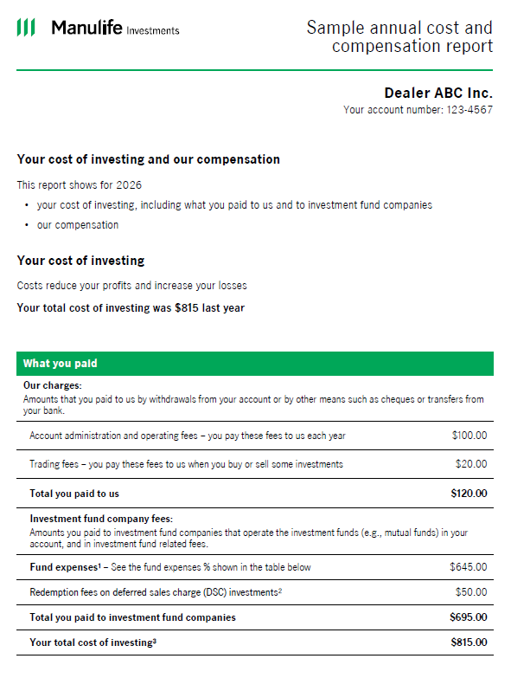
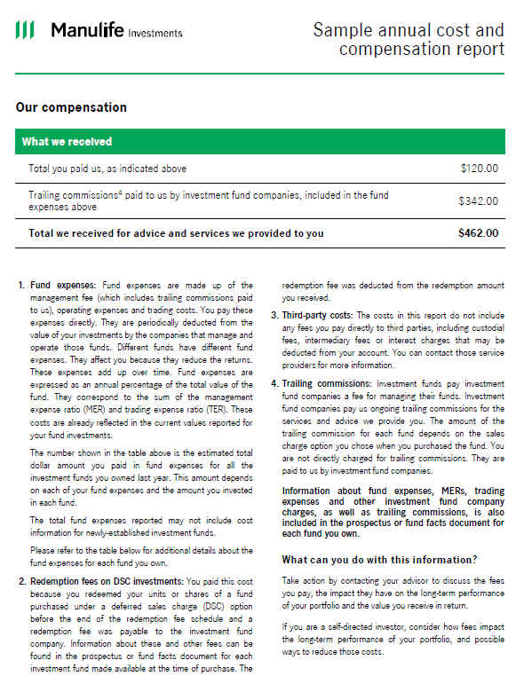
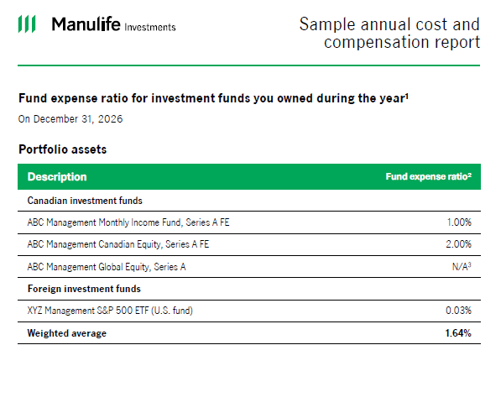
Sample report
For illustrative purposes: sample annual report on charges and compensation, which incorporates total cost reporting, including fund expenses, direct investment charges, and dealer compensation, to help investors make informed financial decisions.
Source: https://www.manulifeim.com/retail/ca/en/resources/all/regulatory/tcr-sample-statement
Notes:
Here is a sample Annual Report on Cost and Compensation (ARCC) to illustrate what clients may see.
This is for illustrative purposes and simply a hypothetical scenario. As you can see, it incorporates total cost reporting, including fund expenses, direct investment charges, and dealer compensation. It can be found on the Manulife Investments website by searching “Understanding TCR”. Remember to verify with your dealer when ARCC will be made available to you, and take the time to better understand it so that you will be prepared in advance to answer any client inquiries when they receive it.
A key point to reinforce is that TCR disclosure is annual, not quarterly. Clients will still receive their regular account statements, but the enhanced cost information will appear in the annual cost and compensation reporting.
This matters because clients may not react immediately when they receive regular statements. The more significant conversations may happen when the annual report arrives, and clients see costs consolidated in one place.
Why regulators did this:
The CSA stated that the FER requirement was moved from quarterly/monthly statements to the ARCC because consolidating all cost information into a single annual report would better support investors' understanding.
The proactive advisor should not wait for that moment. By preparing clients in advance, the annual report becomes a confirmation of a conversation already held, not a surprise that starts the conversation on the client’s terms.

Slide 14
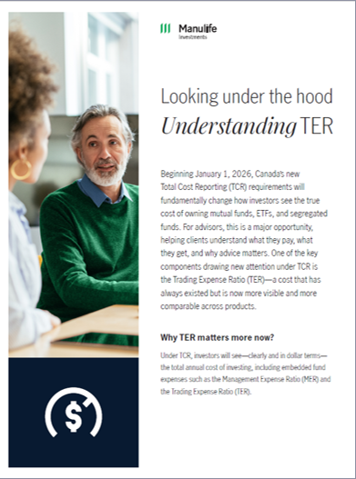
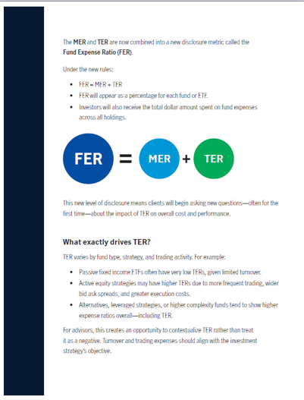
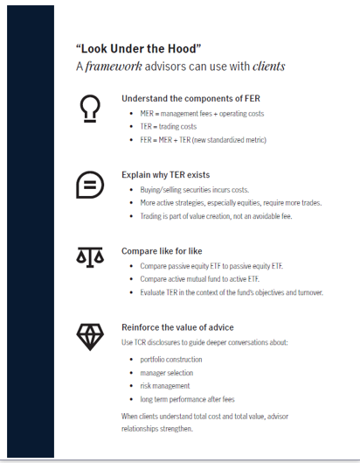
www.manulifeim.com
Source: https://www.manulifeim.com/retail/ca/en/resources/all/regulatory/understanding-ter
Notes:
If you are looking for additional information, explained in a clear and simple format, please visit our website – www.manulifeim.com, as there is already information made available to help you get started on understanding TCR.
You will have to log in, as it is for advisor use only. I invite you to review these resources before client meetings and identify language that feels natural, compliant, and easy for clients to understand.

Slide 15
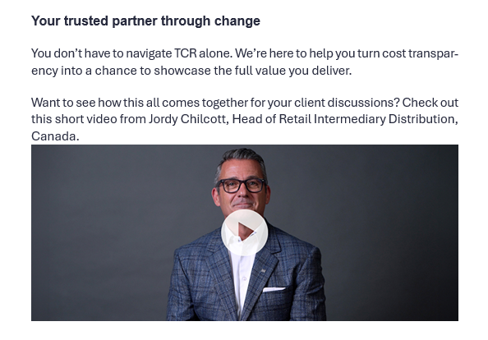
www.manulifeim.com
Notes:
This is another resource available through Manulife Investments.
The video features Jordy Chilcott, Head of Retail Intermediary Distribution, Canada, providing a clear overview of TCR and the opportunity for advisors.
We will not play the video during this presentation, but it may be useful for advisors who want a concise overview or who want to reinforce the mindset that this is not only a regulatory change. It is an opportunity to lead with transparency.

Slide 16
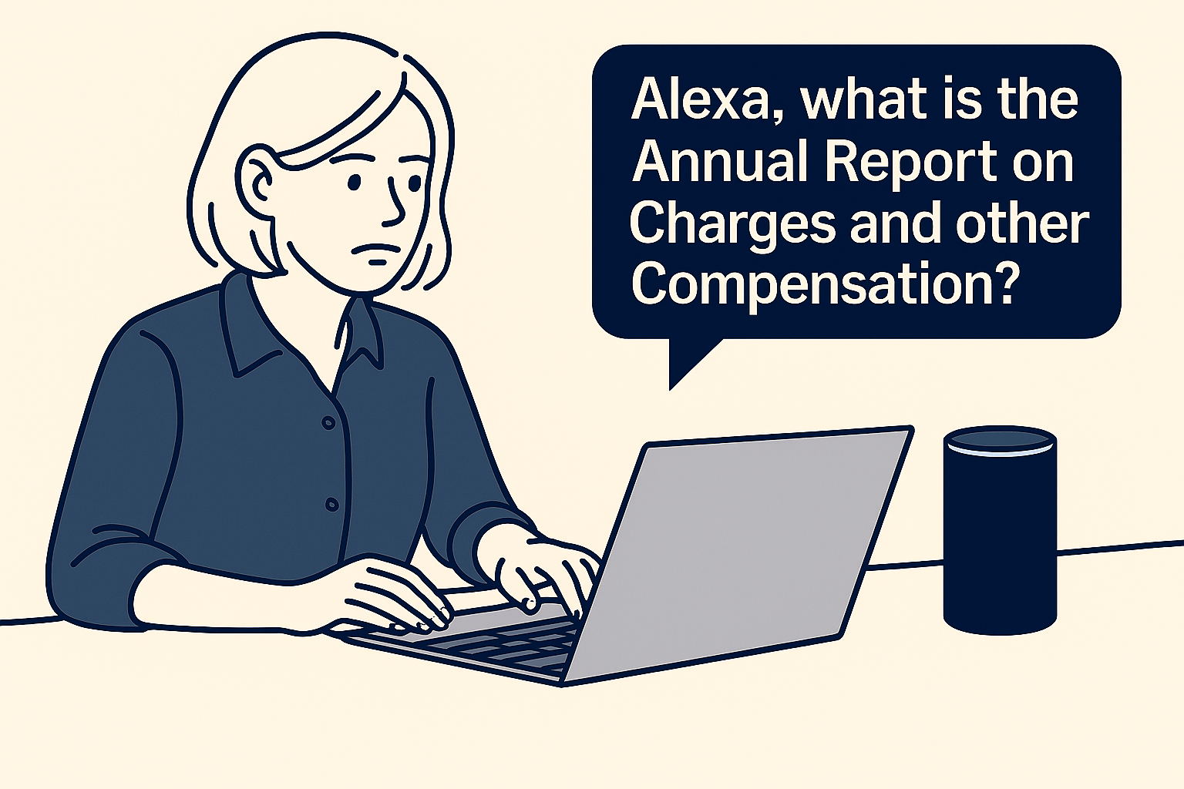
Implications for advisors – risk or opportunity?
Control the narrative or react to it
Notes:
I also want to highlight a key point: Some advisors may be thinking, "Why raise the issue before the client asks?" Why do I have to do so much work before the report is sent to clients?
The answer is that silence creates space for someone else to define the story. Clients have access to more information than ever, including online searches and AI tools. If they are surprised by the report, they may look for answers elsewhere before speaking with you.
Do you want to control the narrative or react to it? A reactive approach can make the conversation feel defensive. A proactive approach communicates confidence, transparency, and leadership.
This does not mean every client will be concerned, nor that many of you have not already had fee conversations. It simply means TCR is a good reason to revisit the practice, identify blind spots, and make sure the team is ready with a consistent message.

Slide 17
Reframe to value-based conversations
17
Notes:
Now, let’s move on to the second element of this presentation – Reframing the conversation.
In essence, we must continue to ensure the conversations are tied to the value your clients are obtaining and will continue to receive, not just the fees they pay.
The goal is not to avoid the fee conversation. The goal is to place it in the right context.
Clients pay costs, but they are really evaluating value. Value may come from the plan, the advice, the decisions avoided, behavioural coaching during difficult markets, tax planning, retirement income design, risk management, estate considerations, or simply feeling more confident.
TCR creates an opportunity to make those contributions more visible. If the conversation stays only on cost, it can become narrow. If it connects cost to outcomes and advice, it becomes a value conversation.

Slide 18
Understand client sentiment
?
Confusion
$
Anchoring on
dollar amounts
!
Surprise
?
Questioning
status quo
Notes:
As you know, a major part of your role as an advisor is managing human behaviour. I often ask advisors: Are you an investment manager, or are you a manager of investors? In reality, many of the most important moments in advice involve helping clients interpret information, manage emotion, and make better decisions.
TCR may trigger surprise, confusion, anchoring on dollar amounts, or questions about the status quo. That does not automatically mean the client is dissatisfied. It may simply mean the information is being presented in a way that feels more concrete.
Keep in mind, the way information is framed significantly affects how it is perceived. Percentages are abstract and often ignored, while dollar amounts feel concrete and personal. A fee expressed as 1.25% may not trigger an emotional response, but the same fee shown as $5,000 can feel immediate and significant – even if nothing has changed. Dollar fees trigger stronger emotional reactions than equivalent percentages, making costs feel immediate and significant. Percentages feel abstract, while dollars feel concrete and personal.
Your role is to normalize the reaction, provide context, and guide the conversation back to the plan, the outcomes, and the value of the relationship.

Slide 19
Common client questions
What exactly is changing on my report?
When will I first see this new reporting?
Will my actual fees increase because of this change?
What services are included in the amount I’m paying for advice?
Why didn’t anyone explain this to me before?
What am I really paying you for?
Can I get the same thing for less somewhere else?
Are these fees worth it given my returns?
Should we switch to something cheaper now?
Notes:
To better prepare yourself and your team, anticipate common questions, such as those listed here. These are examples of questions clients may ask once the reports become more visible.
Some questions will be technical: What exactly changed? When will I first see this? Are my fees increasing?
Other questions will be emotional or value-based: What am I paying you for? Is this worth it? Can I get the same thing for less somewhere else?
What is important to keep in mind is that when information becomes simpler, it naturally invites comparison and questions. In fact, even satisfied clients may pause when they see costs presented differently. Remember, this does not signal dissatisfaction; it could, in fact, reflect engagement among many clients.
You should expect curiosity and be prepared to guide interpretation. By anticipating these moments and addressing them openly, advisors can reinforce trust and demonstrate confidence in the value they provide. The key is to respond with confidence, not defensiveness.

Slide 20

Remember…
Notes:
NOTE TO SPEAKER: If feasible and done in-person, perhaps go out to the audience to ask for a show of hands – who has a clearly articulated value proposition? If virtual, can simply ask the question as a “reflection” on their part to help them realize/think about their own value prop, or whether they even have one.
We have all heard the expression, “price is only an issue in the absence of value”. Let me repeat that, “price is only an issue in the absence of value”!!
People do not buy a price, a product or a service. People buy their PERCEPTION of a price, product, or service. That means the way clients understand your value matters as much as the work itself. Let me share some interesting information/data that highlights this notion of perception.
CLICK

Slide 21
Fee-transparency gap
However, two-thirds
of investors are still
not confident they
understand the fees they pay.
94%
of investors are satisfied with their advisor
92%
of investors
trust their
advisor
74% said their advisor was worth every dollar they pay…
…yet only 44% felt their advisor provides high value.
Sources: Canadian Mutual Fund & Exchange-Traded Fund Investors Survey, IFIC and Pollara, 2024. Value of Advice, Vanguard Canada, 2024.
Notes:
As you will see, there is a meaningful fee-transparency gap or perhaps a disconnect:
In a recent Pollara study, 94% of investors said they were satisfied with their advisor, and 92% said they trusted their advisor.
CLICK
However, only two-thirds (67%) said they were confident they understood the fees they pay, including MERs and fees paid to advisors and dealer firms.
Here is something also interesting from a different study:
CLICK
74% said the advisor was worth every dollar they pay… yet only 44% of Canadian investors felt their advisor provides high value.
Why does this matter? This is a story of “expectation vs. experience” – clients may feel the advisor is worth it, but many still do not clearly understand fee disclosure or fee impact. Investors value advisors, but many still do not understand what they pay.
https://www.newswire.ca/news-releases/ific-and-pollara-release-2024-canadian-mutual-fund-and-etf-investor-survey-results-869091517.html
https://www.vanguard.ca/content/dam/intl/americas/canada/en/documents/Press-Release-Vanguard-Value-of-Advice-Poll_FINAL.pdf

Slide 22
Opportunity – build connections
One-third of investors still lack clarity on how fees are calculated = opportunity to strengthen trust and differentiation through clearer communication.
Provide clear and regular communication.
Make investors feel supported and understood, including personalized advice.
Building confidence and trust through responsiveness, relevant communication, and proactive engagement.
Speed and accessibility – investors equate responsiveness with respect, competence, and reliability.
Investors want to feel as though they have
a partner.
Source: High Net Worth & Mass Affluent Research Report, Manulife, February 2026.
22
Notes:
So, this is an opportunity… an opportunity to build connections.
About one-third still lack clarity on how fees are calculated, creating an opportunity to strengthen trust and differentiation through clearer communication.
CLICK
Investors want to feel as though they have a partner. As such, financial advisors need to build a connection with investors by:
CLICK
Providing clear and regular communication (timelines, fees, investments, information, etc.)
Making investors feel supported and understood, including personalized advice (not generic recommendations), active recommendations, helping them work towards their short- and long-term goals, etc.
Building confidence and trust through responsiveness, relevant communication, and proactive engagement.
Speed and accessibility, as investors equate responsiveness with respect, competence, and reliability.

Slide 23

Russell Investments, “Value of a Canadian Advisor Report”
VALUE OF A FINANCIAL ADVISOR
AVERAGE FINANCIAL ADVISOR FEE
A
Active rebalancing
and asset allocation
0.28%
B
Behavioral coaching
1.43%
Is greater than
1.50%
C
Customized family
wealth planning
1.13%
T
Tax-smart planning
and investing
0.68%
TOTAL
3.52%
Source: 2024 Value of an Advisor Study, Russell Investments, 2024.
Notes:
So, your clients are willing to pay you a fee, but the question is, how do you put a value on your value?
Let’s take a look at some research that may help. Russell Investments Canada Ltd. confirms the value that you bring to your clients in a research report titled “2024: Value of a Canadian Advisor Report.”
In this report, Russell estimates that the value each of you brings to your clients can be at least 3.52%.
They break it out as follows:
A = Active rebalancing and asset allocation, which Russell assigns .28% in value
B = Behavioral coaching, which Russell assigns the highest value of 1.43%
C = Cost of customized family wealth planning. Russell says this adds 1.13% in value. And,
T = Tax-smart planning and investing, which Russell values at .68%...
For a total of 3.52%.
Now, just to be clear, Russell is not implying that by working with you, you will add 3.52% in additional return annually; they are simply quantifying the value of all the work and guidance you provide when you deliver these services to your clients.
Research has always shown that clients are willing to pay fees. They just want to make sure they receive value. While it is sometimes hard to quantify, people know value when they see it, and they know value when they experience it!
ADDITIONAL SPEAKER NOTES IF DESIRED:
According to Dr. Moira Somers, people typically seek financial advice not just for technical help with money, but because they are facing (or anticipating) a major life transition, feeling uncertainty or anxiety, and want reassurance, clarity, and support in making and sticking to important financial decisions.
She emphasizes in her book “Advice That Sticks” that clients usually come to advisors when:
They are at key turning points (retirement, divorce, inheritance, job change, business sale, illness).
They feel overwhelmed, guilty, or worried about money and want relief from stress, not just better returns.
They want a thinking partner – someone to help them sort options, create a plan, and follow through on actions, rather than just receive information.
In short, Somers frames financial advice as a response to emotional, relational, and life‑change needs as much as to numeric or technical ones, not simply “how do I get higher returns?” but “help me make good decisions and feel okay about my financial life.”

Slide 24
How do I explain the value of my advice in the context of TCR?
Positivity
Simplicity (less technical jargon)
Open communication
Create a value inventory
Notes:
Some of you may be asking yourselves, “How do I explain the value of my advice in the context of TCR?”
Start with positivity. Do not apologize for the disclosure, and do not frame it only as something the regulator is forcing you to do. Position it as enhanced transparency that helps clients better understand the full picture.
Use simplicity. Avoid technical jargon whenever possible. The more technical the explanation, the more likely the client is to disengage or become confused.
Open communication can lead to dynamic discussions. Keep communication open. Invite questions, acknowledge concerns, and connect the answers back to the client’s goals and plan.
I will elaborate a little more on these first two points later as I want to focus on this next item…
Creating a value inventory. Make the intangible tangible. Clients often forget how much work has been done over the course of the relationship. Your job is to help them see the process, guidance, service, and decisions that have shaped their progress.
Let me provide you with a few examples…
CLICK

Slide 25
You do a lot for your clients…
Financial management | Investment management | Risk management | Tax planning | Retirement planning | Estate planning
Net worth | Risk tolerance assessment | Life insurance | Tax deferral | Registered plans | Wills
Cash flow | Asset allocation | Disability insurance | Tax minimization | Pension plans | Power of attorney
Debt/credit management | Portfolio construction | Critical illness | Tax avoidance | Government benefits | Trusts
Progress to goals | Rebalancing | Business owner buy-sell | Credits | Housing decisions | Beneficiary designation
 | Asset location |  | Deductions | Succession plans
Notes:
How many of you in this room can say that your clients remember everything you have done for them? Actually, let me ask a different question: Are your clients aware of everything (all the services) they can obtain from you?
You do a lot for your clients. Let’s take a moment to look at this (the speaker can decide to keep it at a high level or focus on one or two areas).
If clients only associate the advisor relationship with portfolio performance, then the value conversation becomes too narrow. This is why a value inventory matters. It helps you document and communicate the full range of work you do.
Consider where this information appears in your business: On your website, in the discovery process, at the annual progress meeting, in the service calendar, in onboarding materials, or on the client review agenda.

Slide 26

Personalized investment approach (sample)
6
Monitor progress and make necessary adjustments.
5
Execute investment strategy.
4
Portfolio construction: select platforms and product solutions.
3
Develop asset allocation strategy.
2
Determine risk tolerance and capacity for loss.
1
Establish investment goals and objectives.
For illustrative purposes.
26
Notes:
Here is a hypothetical visual to represent your personalized investment approach.
This is a typical investment management process for financial advisors using fee-based advisory platforms and the products and solutions available on them. We encourage you to create a visual like this to represent your process.
A visual process like this helps clients see that investment management is not just product selection.
Once you create a visual for your personalized investment approach, I would encourage you to use it whenever you meet with a client about their portfolio. Obviously, when you are first setting it up. But consider using it in a portfolio review, or even if a client has a question. You might say something like, “Before we get into your portfolio update, let me remind you of our investment approach and how it works” (and then show them the visual).
This positions the portfolio within a disciplined process rather than a collection of products. It also helps connect costs to the work being done and the decisions being managed.
(Talk through the visual if time allows)

Slide 27
Financial planning process (sample)
“Fit” meeting
Clients identify their goals, values, special considerations or challenges, and attitudes to risk.
Introduce our practice, fee structure, and the client experience.
Collect/upload documents.
Commitment to move forward.
Presentation of plan
Interactive plan presentation – ability to modify in real time.
Discuss investment management/portfolio construction process.
Commitment to move forward.
Present investment recommendations
Present investment portfolio recommendations.
Provide investment education as needed.
Commitment to move forward.
Input data and identify gaps
May require additional meeting to clarify data.
Analyze potential solutions/recommendations and create plan.
Stress test plan.
Implementation
Execute agreed-upon financial planning tactics.
Schedule follow-up meetings and/or tasks.
Construct investment portfolio.
Execution and service
Client onboarding.
Execute agreed-upon investment recommendations.
Technology demonstration.
Schedule first quarterly review.
Legend
Client-facing meetings
Meeting prep
Source: hypothetical example.
27
Notes:
Now let’s move on to financial planning. This visual shows a sample financial planning process. Remember, the research I shared early (slide 21 fee-transparency gap) showed a big disconnect between what investors want and what they perceive they are getting when it comes to financial planning or value from their advisor).
In this visual, the green (or above the line) activities are client meetings. The blue (or below the line) activities are the behind-the-scenes work your team is doing for the plan and the client. The client-facing meetings are only part of the work. Behind the scenes, the team collects information, reviews documents, analyzes gaps, stress-tests the plan, develops recommendations, prepares for implementation, and coordinates follow-up.
Clients often see the meeting. They may not see the preparation.
The middle line could even be turned into a timeline with the number of days between meetings if you wanted to.
Again, I would encourage you to use a sample visual like this whenever you are delivering or updating the client’s financial plan. You might say something like, “As a reminder, this is our financial planning process. Let me walk you through your financial plan (or your update) so that you can see the process at work.”
[Talk through the visual if time allows}

Slide 28
Your progress report
Top Priorities | Retire debt-free by 65
 | Maximize RESP contributions for daughter
 | Set up emergency fund
 | Next phase of financial plan
Challenges | Aging parents – elder-care
 | Business – sell or stay on
 | Mary interested in attending university out of province
Michael
Susan
Financial management retirement planning |  | Tax planning |  | Estate planning
SERVICE | STATUS | SERVICE | STATUS | SERVICE | DETAILS & STATUS
Establish goals and financial plan | Initial discovery meeting completed 02.14.2017. Financial plan completed and reviewed semi-annually. | Tax mitigation | Tax mitigation through Hold Co. since March 2019. | Life insurance | Perm life policy for both – $1.5M on 05.25.2018.
Mortgage and debt analysis | On track to have mortgage paid off by 2034. | Tax optimization | Non-registered account using tax-efficient funds. | Critical illness and disability | Mortgage protection set up 10.10.2018.
Retirement planning | Retirement plan and cash flow forecast completed – 05.12.2017. | Business tax planning | Tax filing through accountant, Jim Smith, since April 2019. | Wills and POA | Updated by ABC Law firm – 04.06.2022.
Cash flow projections |  |  |  | Business succession planning | In progress.
Service and communication | Service agreement created 06.25.2017. |  |  | Risk protection | Portfolio analysis and automatic rebalancing in place to minimize risk.
28
Notes:
Perhaps you may consider what I call a progress report. I stress the term PROGRESS report rather than what we often say: Annual report or annual meeting. An annual review can sound like a routine check-in. A progress report suggests forward movement, accountability, and connection to goals.
I am aware you may already know this, but the language you use or how you frame certain topics/ answers can go a long way to facilitating discussions and maintaining positivity. Language matters. How we frame the meeting can shape how clients experience the meeting.
Over the last few years, every time I show this to advisors, even leading advisors, the feedback is very positive as they appreciate the simplicity and immediately understand the potential and benefits of using this with clients.

Slide 29
Desired relationship with financial advisors
Strategic partner | Coordinators of complexity | Offer advisor-supported digital tools | Transparency, clarity, and support | A coach and confidence builder | Reassurance through information, not just relationships | Desire fee transparency
Source: High Net Worth & Mass Affluent Research Report, Manulife, February 2026.
Notes:
And so, in case you are wondering, do clients really want all this information or more? Well, according to the Manulife High Net Worth & Mass Affluent Research Report, conducted in February 2026, here are some interesting findings regarding investors' desired relationship with their financial advisors.
HNW clients state they want:
A strategic partner,
Coordinators of complexity
Offer advisor-supported digital tools (i.e., dashboards, reporting, selective trading)
Mass affluent clients seem to place a greater emphasis on:
Transparency, clarity, and support
A coach and confidence builder
Reassurance through information, not just relationships
When it pertained to fees, both expressed a desire for fee transparency.
That means TCR is aligned with something clients already want: More clarity. The advisor’s opportunity is to provide that clarity in a way that feels personal, relevant, and connected to the client’s goals.

Slide 30
POLL
How do you feel about your ability to explain TCR changes and reframing the conversation to focus on value to your clients?
Very confident
Somewhat confident
Neutral
Somewhat unprepared
Very unprepared
30
Notes:
Now I have spoken quite extensively about demonstrating your value and sharing some ideas/visuals to utilize with clients to help you make the intangible, tangible. I would like to pause for another brief check-in.
How do you feel about your ability to explain TCR changes and reframing the conversation to focus on value to your clients?
Very confident
Somewhat confident
Neutral
Somewhat unprepared
Very unprepared
This is not just about technical confidence. It is also about communication confidence. Your answer may point to where you should focus your preparation
NOTE TO SPEAKER: Conduct poll if in a virtual setting and share the statistics, If session is in-person, simply ask attendees to reflect on the answer (no need to share with the group) and where they might fit.

Slide 31

When the rules change, success belongs to the people who adapt without abandoning their craft.
31
Notes:
Whether you have been in this industry for over 20 years or even 5–10 years, even moreso as business owners, you are constantly adapting to elements beyond your control (markets, economic events, global pandemics, tax legislation, regulatory reform, etc.).
TCR may feel like another burden, but it does not require advisors to abandon what makes them valuable. It requires advisors to sharpen how that value is explained. It is just part of the process to continuously find ways to improve yourself to ensure you are always ahead of the game.
It is about using a changing environment to improve communication, strengthen process, and lead clients through uncertainty with confidence.

Slide 32
Lead with your playbook
Notes:
Now, let’s move on to the last part of this presentation and focus on practical steps for Total Cost Reporting Readiness. Let me explain what I mean by “Lead with your playbook”.
A playbook is simply a practical structure. It helps you know what to do before, during, and after the conversation. Without a playbook, preparation can feel overwhelming. With a playbook, the process becomes manageable and repeatable.
The goal is to support consistent messaging across the practice, reduce anxiety, and help you move from reactive responses to proactive leadership.

Slide 33
Your playbook
During
Before
After
Before meetings:
Identify key value moments
During conversations: Anchor costs to outcomes
After meetings: Reinforce continuity and commitment
Notes:
In this case, there are three key elements to your playbook:
Before meetings
During meetings
After meetings
CLICK
Before meetings: This is where you may have to take some time to prepare, reflect, and identify key value moments, moments when you helped the client make a better decision, avoid a mistake, gain confidence, simplify complexity, or stay on track.
For example: Calmed a client’s emotions during market correction/global health pandemic, helped a client make a major decision with confidence such as deciding when to draw from their RRSP/RRIF, TFSA, or non-registered accounts, helping with adult children, etc.). This will help you stay confident and focused on priorities, and will also help you with the next part of the playbook, which concerns conversations DURING the meeting…
CLICK
During meetings: For starters, you should not open the meeting by jumping straight into the cost disclosure. Consider first reminding the client what the meeting is about: Their goals, their plan, their progress, and the advice relationship. For effective conversations remember to anchor costs to outcomes as this may provides clarity and supports decision-making. (Tie fees to outcomes). This is where the preparation work before the meeting will be valuable as you will now have the opportunity to connect costs to value moments you identified. Tie the financial need to the emotional desire. For example, to ensure you can pay for post-secondary studies, to ensure you have enough capital to provide you the income during your retirement years, etc.
CLICK
After meetings: Document the conversation – what was discussed, what concerns the clients expressed, next steps agreed to, etc. Then send a follow-up summary via email. Capture client concerns for future meetings (track what the client was primarily concerned about so you can be better prepared in future discussions. Continue making value ‘’visible’’ with small touchpoints. Reinforcing continuity and commitment after meetings ensures lasting client relationships and trust. A clear process/structure reduces can reduce anxiety and improve clarity.

Slide 34
Audit your book
During
Before
After
Not all clients are the same
Top relationships
Mid-tier clients
Smaller/lower-tier clients
Notes:
Another aspect you should include in your process (as part of the “before” stage) is taking time to audit your book.
In working with leading advisors, I can share that they regularly audit their books to ensure they have a solid understanding of their client profiles, profitability levels, and the service levels different categories of clients are offered, to properly manage and run their business. So, this is not just a suggestion pertaining to TCR preparation; it is simply good business practice.
I think you will agree that not every client needs the same conversation at the same time. Top relationships may require proactive, personalized outreach. Mid-tier clients may need targeted communication integrated into regular reviews. Smaller or lower-tier clients may be best served through scalable education and clear access to follow-up support.
This targeted approach makes action manageable and effective.
This is not about treating clients unequally. This is about communicating appropriately based on complexity, relationship value, risk, and need.

Slide 35
Audit your book
During
Before
After
Not all clients are the same
Top relationships
Focus on proactive and personalized discussions with high-value clients to strengthen key relationships.
  Complexity of relationship
  Engagement level
  Emotional risk
Notes:
Prioritize top relationships: Focus proactive and personalized discussions on high-value clients to strengthen key relationships.
Who are your top relationships by revenue, assets, referrals, complexity, or future opportunity? Which households would hurt the most to lose?
Which clients are most likely to compare cost versus value?
You may consider three dimensions:
1. Complexity of relationship:
Which clients receive significant planning beyond investment management?
Which clients have retirement income, estate, tax, business owner, insurance, or family wealth transfer needs?
Which clients may not fully understand all the work being done for them?
2. Engagement level:
Who regularly attends meetings and values advice?
Who has not met with the advisor in a while?
Who may only associate the advisor relationship with investment returns?
3. Emotional risk:
Which clients are anxious, reactive, skeptical, or frustrated after poor market performance?
Which clients may see a large dollar cost and react emotionally?
Which clients are vulnerable to a competitor’s “lower fee” message?

Slide 36
Audit your book
During
Before
After
Not all clients are the same
Mid-tier clients
Routine check-ins to maintain engagement.
Send a targeted email or letter explaining TCR.
Offer a review meeting or call.
Use a “value recap” – highlight key services provided.
Identify one planning opportunity for the next meeting.
Notes:
Mid-tier clients: These clients may not require the same level of white-glove treatment as top relationships, but they should not be ignored.
Who fits here?:
Good clients with moderate assets
Emerging affluent households
Younger accumulator clients with future potential
Clients who are engaged but not highly complex
Clients who may be fee-sensitive but relationship-positive
Clients who could consolidate more assets
What should you do?:
Send a targeted email or letter explaining TCR
Offer a review meeting or call
Use a semi-personalized “value recap” – highlight key services provided
The idea is to maintain engagement without creating an unsustainable workload. Look for one planning opportunity that can make the next conversation valuable and relevant.
TCR can be integrated naturally into routine check-ins rather than treated as a separate event.

Slide 37
Audit your book
During
Before
After
Not all clients are the same
Smaller/lower-tier clients
Use scalable communication.
Provide a short FAQ.
Offer group webinars or scheduled call blocks.
Encourage clients to reach out with questions.
Notes:
Smaller/lower-tier clients: These clients still deserve clear communication, but you will need a scalable approach.
Use scalable communication for this broader client base to maintain contact without overextending resources (telephone, email, virtual meetings). For example:
Send a clear educational message
Provide a short FAQ
Offer group webinars or scheduled call blocks
Use templated language approved by the dealer or compliance team
Encourage clients to reach out with questions
Even a short message can reduce surprise and communicate that the advisor is paying attention.

Slide 38

Refresh/revisit your value statement
Unique Value Proposition (UVP)
1
Analyze
Discover client segments and patterns.
Who do you work with?
2
Identify
What do you do for each client segment?
Keep it simple and memorable.
3
Find your advantage
What sets you apart?
Why should a prospective or existing client work with you?
Examples for illustrative purposes only.
38
Notes:
Another practical step is to refresh or revisit your value statement, or unique value proposition.
We have built a presentation and can also deliver it in a workshop format, so please connect with your Manulife Investments sales representative if you are interested in creating/developing your UVP, or if you wish to take a step back and revisit it to determine whether it is still relevant.
I will keep this at a very high level regarding what it entails.
Start by analyzing your book of business to find a trend in your client segments – identify who you work with, and if you have target markets or segments.
CLICK
Then identify what you do for each client – keep it simple and memorable.
CLICK
And finally, develop a differentiated benefit – what sets you apart?
We encourage you to use specific examples. And remember, if you have more than one target market/niche/segment, you need a unique value proposition for each one!

Slide 39
Building your unique core story (sample)
During
Before
After
Holistic wealth management services
Personalized
investment advice
Qualified team:
Intellectual capital
Holistic financial planning
Retirement planning
Estate planning support
Develop a formal investment policy statement
and investment philosophy
Deliver personalized portfolio construction
and customized reporting
Team experience and focus
(e.g., 50 years’ combined experience
through many different market cycles)
Tax planning support
Longevity planning
Business succession (exit) planning
Monitor performance and results versus client’s stated goals
Stress test the portfolio
Designations – CFA, CFP, CIM
Family coach
Strategic philanthropic
planning
Executive compensation
planning
Provide quarterly
investment outlook and
strategy meetings
Technology assistant/
digital access
Banking and
lending
Risk manager
Your personal CFO
This is your story!
Hypothetical example for illustrative purposes only.
Notes:
Important to note first and foremost is that most teams provide a tremendous amount of value to their clients in so many different ways. But again, what you are trying to do here is boil all of those things down to just “three core competencies.” What would they be?
Well, in this case, it’s providing “Holistic wealth management services,” “Personalized investment advice,” and, finally, “A Qualified team with real intellectual capital.”
Under Holistic wealth management, they will discuss topics such as developing a goals-based financial plan, retirement planning, estate and tax planning support, longevity planning, business succession planning, strategic philanthropy planning, executive compensation planning, and banking and lending services.
Under Personalized investment advice, they will discuss items such as developing a formal investment policy statement and investment philosophy, delivering personalized portfolio construction and customized reporting, monitoring performance and results vs. client’s stated goals, and not an arbitrary benchmark They let their clients and prospects know that they stress test the portfolio 2-3 times per year, regularly provide a quarterly investment outlook and finally engage in quarterly strategy meetings. They are also a risk manager, which can include insurance solutions.
And, under A qualified team with intellectual capital, they will discuss items like: The team’s experience and focus or their niches, they will detail the team’s designations and experience, and why that is important to the client. They will make sure their clients know they consider themselves advisors to the entire family, a financial coach, if you will. They are also a technology assistant, providing digital access to the clients’ accounts. And finally, they are their clients’ personal CFO. If a decision involves anything with a dollar sign, they ask to be involved in the conversation.
Now, when developing your own core story, the key is to list only the things your team actually does! A core story should clarify the advisor’s value, not overstate it.

Slide 40

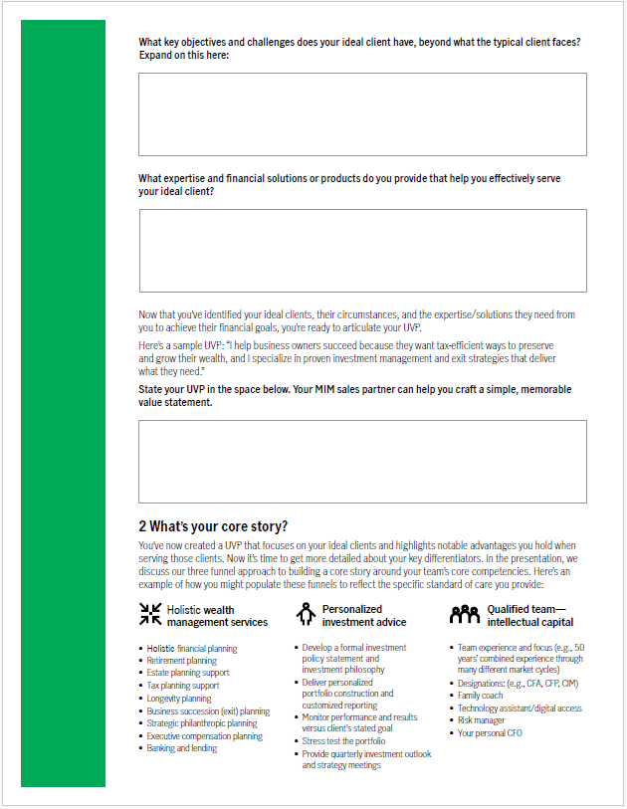
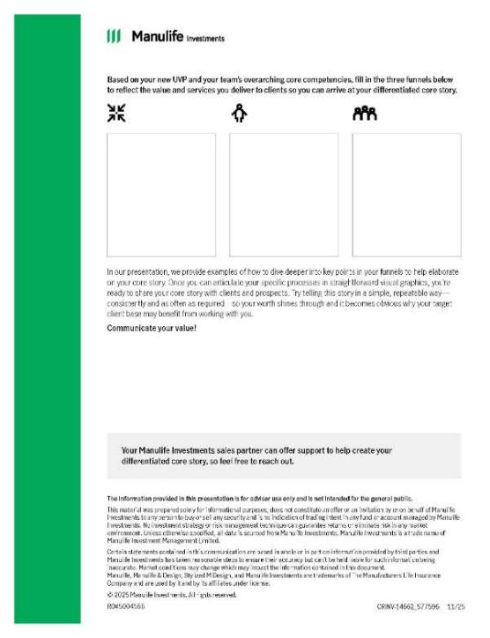
During
Before
After
Communicating your value worksheet
Notes:
Here is a worksheet that we provide to guide you through the value proposition process. It helps translate broad service claims into a more specific and credible story about who you serve, what you do, and why it matters.
TCR is a good trigger to revisit how you describe your value, because clients may soon be looking at cost with more clarity.
Again, if you are interested in our presentation, connect with your Manulife Investments sales representative, and they will be happy to book some time with you to discuss further. We are more than happy to offer a presentation/workshop at your firm.

Slide 41
Make the intangible, tangible
During
Before
After
Control the narrative,
get ahead.
Normalize the discussion –
use stories/
analogies.
For example: Restaurant bill, some restaurants' calorie count for meals,
and travel booking.
Use visuals to reinforce value.
Notes:
Now, let’s move into the second part of the playbook – DURING conversations.
First, control the narrative: Think back to the prep work you did before the meeting (identified key value moments). This will help you proactively introduce the topic, frame it, and connect it to the broader advice relationship. Have a simple agenda ready to set the stage. This may be useful because it tells the client: “Yes, we will discuss fees, but we are not going to make the entire relationship about one number.”
Normalize the discussion, use stories/analogies where appropriate:
For example, you could explain using the analogy of going to a restaurant. When you go to a restaurant, you don’t just see the cost of the meal; you see the full bill, including the food, drinks, tax, and tip. Total cost reporting works the same way. Instead of just seeing the ‘meal’ (the investments), you’ll now see the full breakdown of what everything costs – you simply have more visibility into what was included.
Or booking flights, car ownership, doing home renovations, lots of examples you could leverage.
Use visuals (reinforce value): Recall the visuals I shared with you earlier in the presentation. Bring back your investment process, planning process, progress report, service calendar, or value inventory. Visuals help clients see what they receive, not just what they pay. These are all visuals that remind clients of all the things you do for them or have done for them and with them throughout the relationship. It allows you to make the intangible, tangible.

Slide 42
Keep it CLEAR
During
Before
After
C
L
E
A
R
Clarify
Listen
Explain
Align
Review
Notes:
Keep it CLEAR.
One of the things you may have heard me mention earlier was to avoid technical language/jargon. Use client-friendly language to minimize possible confusion and make it easier for them to understand and engage in the conversation. A simple way to structure the conversation is to keep it C.L.E.A.R.:
Clarify the change. This is where you get ahead of any possible confusion. You should clarify that TCR is about enhanced transparency and visibility, not necessarily new fees. TCR will make investment fund costs more visible to clients, including costs that may not have previously appeared in the same way on annual fee and charge reports.
What the disclosure is showing. Why does the report look different? What costs are now more visible? What has changed in reporting? What has not changed in the client’s actual investment arrangement? That transparency is a positive thing, but it needs context.
Listen for reactions. Give the client space to react before jumping into explanation mode. This is important because not every client will have the same concern. One client may be confused. Another may be surprised by the dollar amount. Another may wonder whether they are getting enough value. Another may compare the cost to a lower-cost platform.
Explain what it means. The client does not need a regulatory lecture; they need a clear explanation. Consider asking the client to explain it back to you (if you and they are comfortable doing so), as it will help determine if they understood. If the client cannot explain it back simply, perhaps it was not explained clearly enough.
Align cost to value. Connect the cost discussion back to the client’s goals, plan, and value moments. For example, the client’s financial plan, their retirement goals, their income needs, their portfolio strategy, their risk tolerance, their tax situation, their family priorities, the advice and service provided, the decisions the advisor helped them make or avoid.
Review next steps. End the conversation by reviewing what was discussed and confirming next steps. This prevents the meeting from ending on the fee disclosure. Bring the conversation back to action, confidence, and forward momentum.

Slide 43
AFTER conversations
During
Before
After
A
F
T
E
R
Assess
Follow-up
Tailor
Evaluate
Reconnect
Notes:
Now we get to the third step or element of the playbook – AFTER conversations.
What are some of the things that are important for you to keep in mind and act on after the client meeting/conversation?
Assess the reaction. Document how the client responded: confident, uncertain, or fee-sensitive. How the client reacted, what they understood, and whether there are unresolved concerns. That helps determine which clients may need more proactive outreach.
Follow up with a recap. Send a timely follow-up that reinforces clarity, value, and next steps. This is where you lock in the message. If the client leaves the meeting and later looks at the report (ARCC) again, the advisor’s follow-up should remind them of the context. Send a brief note reinforcing the core message about visibility/transparency, for example: What we reviewed, what we clarified, what we connected it to and what happens next.
Tailor the next step. Segment your follow-up based on the household’s level of concern, complexity, and need for further education. Some clients may only need a simple summary. Others may need a second conversation, a planning update, or a more detailed value review. This is where advisors move from a one-size-fits-all response to a segmented, client-specific approach.
Evaluate opportunities and risks. Review whether the portfolio, service model, or value communication needs strengthening before the first enhanced annual report is delivered. Also, advisors should ask themselves whether the client truly sees the value, and if not, why not.
Example reflection questions: Does the client associate me only with investment performance? Did I clearly communicate my value before the fee conversation? Did I clearly communicate my value before the fee conversation? Did I clearly communicate my value before the fee conversation?
Reconnect with the client after the immediate follow-up to reinforce confidence and continue making value visible. The mistake advisors should avoid is treating the TCR meeting as a one-time event. The better approach is to use the conversation as a starting point for deeper engagement. Depending on the client, consider a touch point 30 days after the meeting: “I wanted to check in after our recent discussion to see whether any other questions came up after reviewing your report.” Reconnect with purpose so the value conversation continues beyond the TCR meeting.

Slide 44
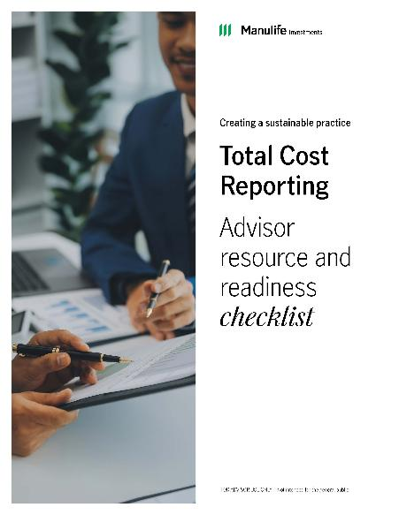
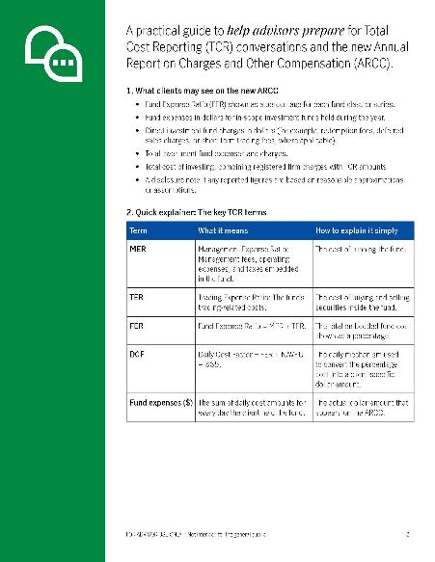
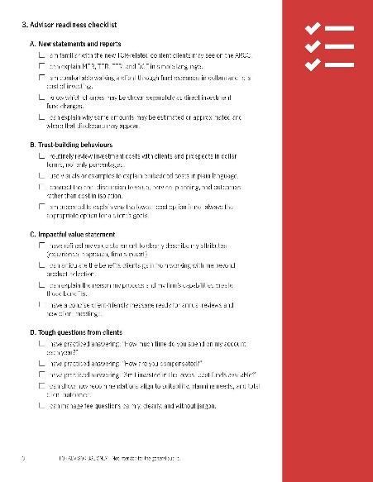
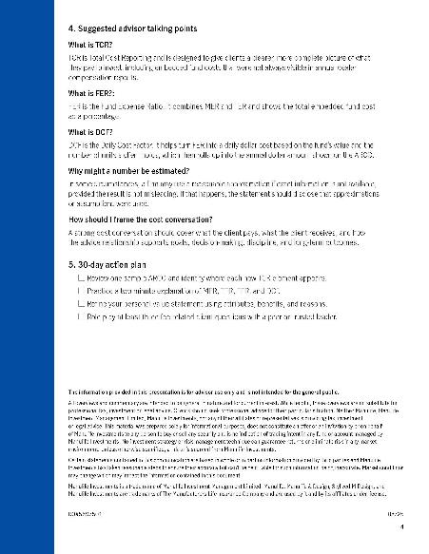
Total Cost Reporting Advisor resource and readiness checklist
Notes:
Here is a resource and readiness checklist to help you.
The message is that the concepts we have discussed should become practical action. You don’t need to rely on memory or improvisation. A checklist helps translate the playbook into specific behaviours before, during, and after client meetings.
NOTE TO SPEAKER: If time allows, point out how the resource can be used by advisors and their teams to assign responsibilities, prepare client segments, and standardize follow-up.

Slide 45
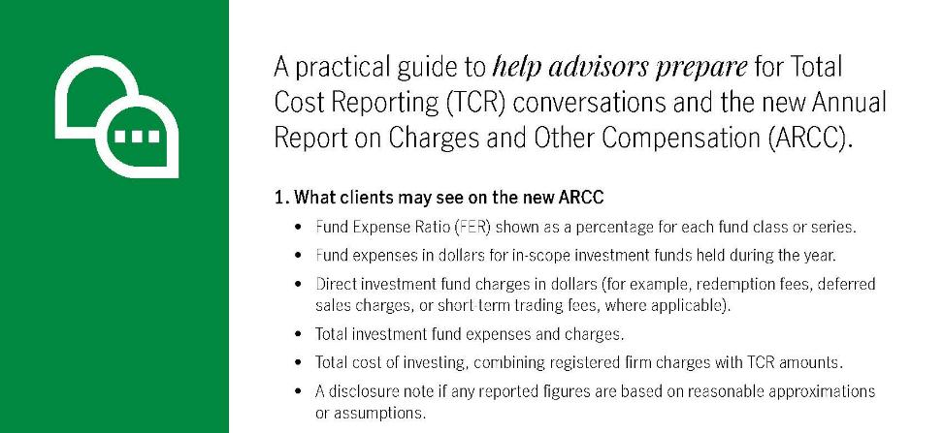
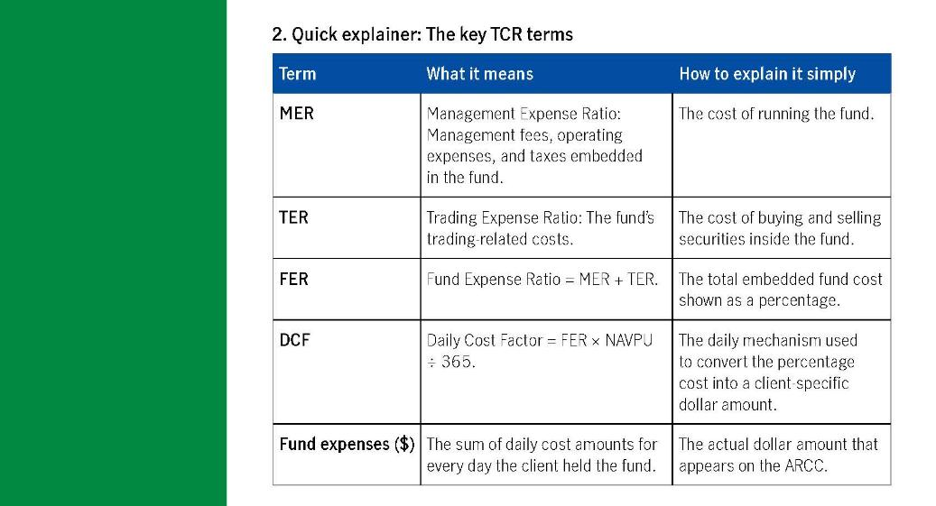
Section 1 and 2
Notes:
Let’s take a look at each section a little more in depth. As you can see, at the very top of the resource, we provide some information ( at a glance) regarding what clients may see on the new ARCC ( Annual Report on Costs and other Compensation).
Then, in section 2 , we provide you with a “Quick Explainer” which is simply an overview of key TCR terms, what each term means and how to explain it simply.

Slide 46
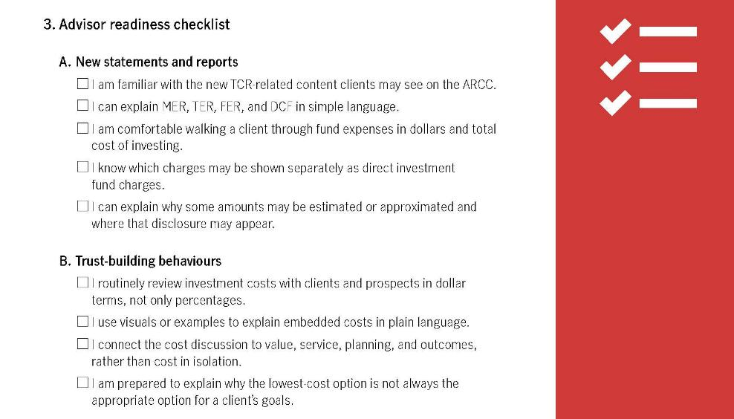
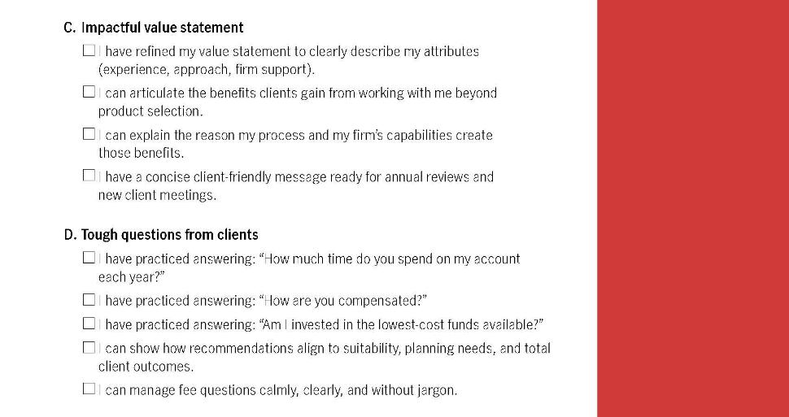
Section 3
Notes:
In section 3 we have created a “Readiness Checklist”. As I stated previously, this checklist helps translate the playbook into specific behaviours before, during, and after client meetings. This is just a snapshot of key items you need to check-in with ( and with your team, if you have a team) to ensure you have properly prepared for upcoming or on-going conversations with clients

Slide 47
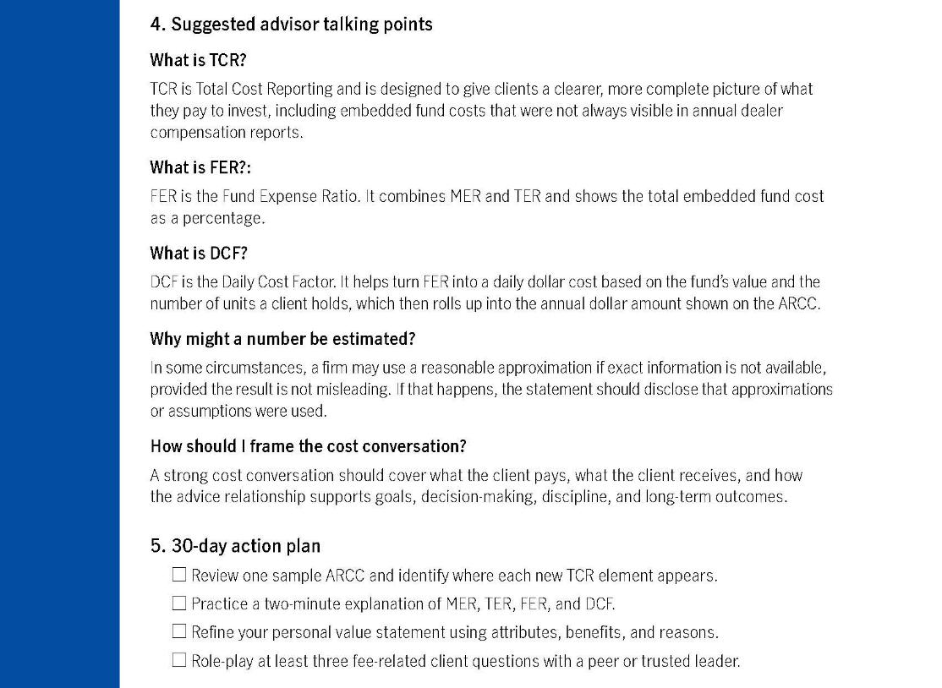
Section 4
Notes:
In section 4 we provide you with some high-level speaking points in the event you may need some guidance or if you simply wish to tweak your language/responses to some potential client questions or areas that may need addressing by you during client conversations.

Slide 48
Recap
Clearing the clutter
Reframe the conversation
Lead with your playbook
Notes:
Let’s do a quick recap of what was discussed today:
First, we cleared the clutter by reviewing what TCR is, why it exists, what it covers, what may be excluded, and the key metrics advisors should understand.
Second, we looked at reframing the conversation from cost alone to value, trust, and client outcomes (on what matters), and how you have and continue to deliver value.
Third, we introduced a playbook to help advisors prepare before meetings, lead during meetings, and reinforce confidence after meetings.

Slide 49
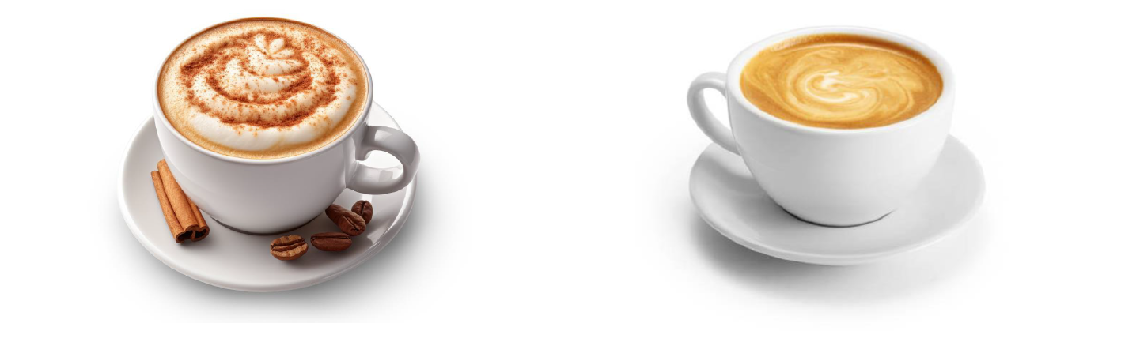
Advisor perception
Client perspective
Notes:
Why does this matter? Why should you invest the time?
Well, too often (and I am generalizing here) when speaking with advisors and asking them to evaluate or comment on their business/practice, the advisor's perception of their business (CLICK for animation) overall is that things are great, my clients love me, there are no issues, they are happy.
However, (CLICK for animation) when you speak with clients about their perspective on their relationship with their advisor, it may not always align. It’s not bad. It’s likely just OK. Remember, some of the data we shared earlier in the session regarding client expectations and perceptions – there is a disconnect from what clients say and what they see as value from the advisor.
So, my question to you is, what lens are you using to view your business? The advisor lens, or the client lens? Put yourself in their shoes, and perhaps you can have a better perspective of the value of your offering as to how it is meeting client expectations
Remember what I said earlier regarding price vs. value: People don't buy a product, a price, or a service. They buy their perception of a product, price, or service.

Slide 50

A relationship moment
Transparency builds trust.
Explaining value clearly
=
reinforcing trust and satisfaction.
Confident leadership inspires client confidence.
Notes:
What’s in it for you?
Total Cost Reporting is not just a compliance requirement; it is a relationship moment. Advisors who embrace transparency, explain value, and lead with confidence can deepen trust and strengthen long-term client relationships.
Transparency builds trust. Explaining value clearly reinforces trust and satisfaction. Confident leadership inspires client confidence.
Your role is to bring the discussion back to value: what has been done for the client, what is being done now, and what will continue to be done.
Handled well, TCR can open the door to deeper conversations about goals, priorities, planning, and the broader relationship.
It can also differentiate you from prospects. If you’re transparent from day one and can clearly explain what clients receive, you set a different tone for the relationship.

Slide 51
TCR is your opportunity to lead the conversation so that clients hear the value of our advice from you first, not from a search engine or someone else.
Notes:
In closing…
TCR is your opportunity to lead the conversation, so clients hear the value of our advice from you first, not from a search engine, a competitor, or someone else.
(Additional info for the speaker):
TCR is your opportunity to re-engage in proactive, plain language fee explanations. While you must initiate the discussion rather than waiting for clients to ask about fees, always keep in mind that active listening offers a greater opportunity to strengthen trust, satisfaction, and retention by understanding what is valuable to the client and highlighting these outcomes.

Slide 52
Next steps
Within the next 30 days:
Review your “Value Inventory” and write down 3 value moments you’ve delivered to each of your top 20 clients.
Practice explaining one of them.
Weave this into client meetings over the next quarter.
Notes:
Here are three practical next steps for the next 30 days:
1. Review your “Value inventory” and write down 3 value moments you’ve delivered to each of your top 20 clients.
2. Practice explaining one of those value moments in plain language so that you sound natural, confident, and client-friendly.
3. Weave this into client meetings over the next quarter (as determined by your planned client outreach strategy when you audited your book).
A small amount of preparation today can prevent a much more difficult conversation later.

Slide 53
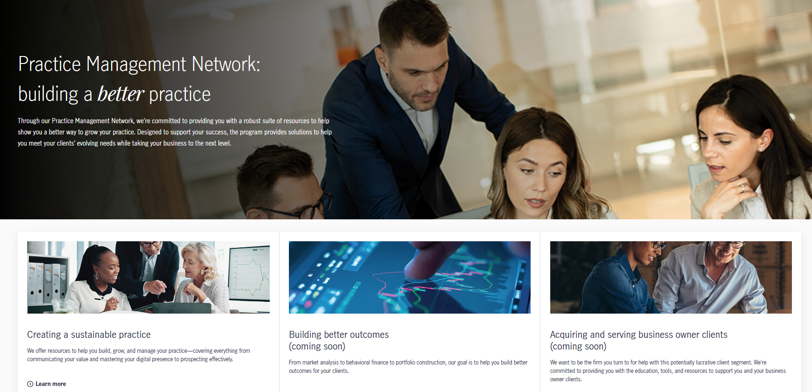
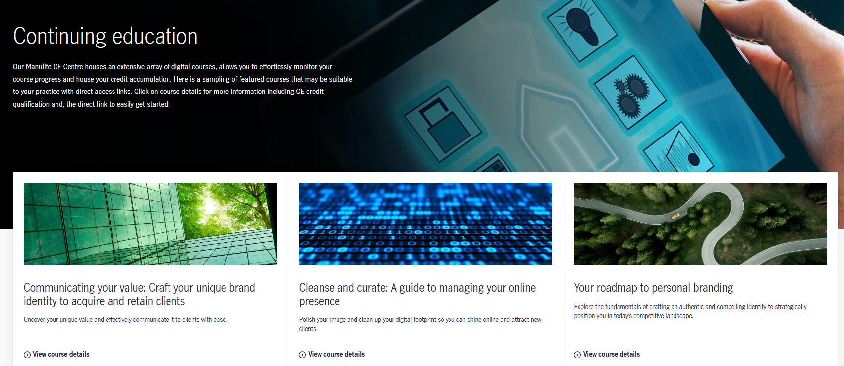
Your trusted partner – Manulife Investments
Notes:
Manulife Investments is here to support advisors through this transition.
If you require additional info on this topic, Manulife Investments is here to support you with Continuing Education, as well as additional thought leadership material from my team and the Practice Management network. Simply visit the Manulife Investments website or contact your sales representative for more details.

Slide 54
Thank you
Notes:
Thank you all very much for your time today!

Slide 55
Important information
The information provided in this presentation is for advisor use only and is not intended for the general public.
All overviews and commentary are intended to be general in nature and for current interest. While helpful, these overviews are no substitute for professional tax, investment or legal advice. Clients should seek professional advice for their particular situation. Neither Manulife, Manulife Investment Management Limited, Manulife Investments, nor any of their affiliates or representatives is providing tax, investment or legal advice.
This material was prepared solely for informational purposes, does not constitute an offer or an invitation by or on behalf of Manulife Investments to any person to buy or sell any security and is no indication of trading intent in any fund or account managed by Manulife Investments. No investment strategy or risk management technique can guarantee returns or eliminate risk in any market environment. Unless otherwise specified, all data is sourced from Manulife Investments.
Certain statements contained in this communication are based in whole or in part on information provided by third parties and Manulife Investments has taken reasonable steps to ensure their accuracy but can’t be held liable for such information being inaccurate. Market conditions may change which may impact the information contained in this document.
Manulife Investments is a trade name of Manulife Investment Management Limited. Manulife, Manulife & Design, Stylized M Design, and Manulife Investments are trademarks of The Manufacturers Life Insurance Company and are used by it and by its affiliates under license.
RO#5697399 08/26

